Slide 1


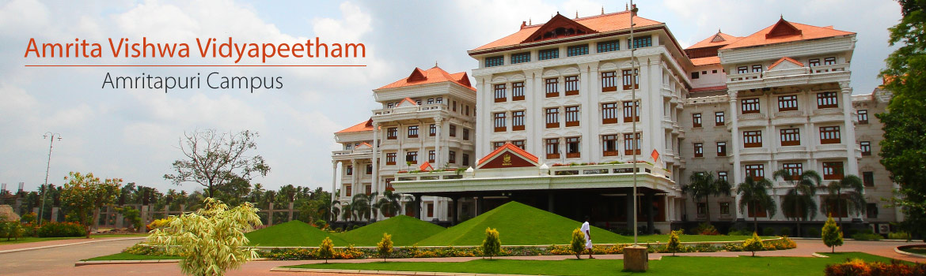
Fine Tuning

Slide 2
Outline
Training Cycle – LLM
Instruction-tuning
Full Parameter
PEFT
Additive
Adapters -Sparse Adapters-IA3
Soft prompt-Prompt Tuning-Prefix Tuning-P-Tuning-LlaMA Adapter
Selective
BitFit-Freeze and Reconfigure
Reparameterization ( LORA,QLORA)
Hybrid method that is a combination of Reparameterization and Selective

Slide 3


Training Cycle - LLM
The training cycle for a LLM consists of 3 main stages:
Pre-Training
Instruct
Safety
5
Notes:
“Let’s walk through the training cycle of a Large Language Model — like GPT. It’s a multi-stage process designed to move from raw language understanding to safe, instruction-following behavior.”
🧠 1. Pretraining Phase: The Foundation
"First, we have the pretraining phase. In this stage, the model learns general language patterns and world knowledge from a vast and diverse corpus of text — this includes books, articles, websites, and more.
The training is self-supervised, meaning the model learns by predicting the next word or filling in blanks in sentences — no labeled data is required.
This phase gives the model a broad understanding of language, but it doesn’t yet know how to follow instructions or interact with users in a meaningful way."
📘 2. Instruction Tuning: Teaching the Model to Follow Orders
"Next is the instruction tuning phase. Here, the goal is to make the model actually follow instructions — to respond helpfully, clearly, and contextually.
This is done using supervised fine-tuning, where we provide examples of tasks along with ideal responses.
For example, we might show it:
A question → and the correct answer
A task → and the appropriate completion
This helps the model become more usable for everyday tasks like answering questions, summarizing, or translating."
🛡️ 3. Safety & Alignment: Making It Trustworthy
"And finally, we enter the safety and alignment phase.
Even a helpful model can produce harmful or biased content. So, we refine it further using a technique called Reinforcement Learning from Human Feedback, or RLHF.
Here’s how it works:
Human reviewers rank model responses based on safety and quality.
A reward model is trained from this feedback.
The LLM is fine-tuned using this reward model so that it produces better, safer outputs.
We also conduct red-teaming — where experts try to break the model with adversarial prompts — and apply filters and moderation tools to further reduce harmful outputs.
The result is a model that’s not just smart and helpful, but also aligned with human values and safer for deployment."

Slide 4


Training Cycle - LLM
Objective:
The goal of pre-training is to teach the model general
language understanding.
Process:
The model is trained on a massive dataset of text from the internet and other sources.
Pre-Training
Outcome:
A base model that has a general understanding of the language.
self-supervised
Protopapas
6

Slide 5


Training Cycle - LLM
Objective:
The goal is to make the model useful for specific
tasks and improving its ability to follow instructions.
Process:
Fine-tuning the model on datasets that contain instructions and the desired outputs.
This also includes RLHF.
Outcome:
A model that becomes better at interpreting and following user instructions.
Instruct
supervised fine-tuning
Protopapas
7

Slide 6
Training Cycle - LLM
Objective:
The goal is to make sure that the model outputs are
safe and ethical.
Process:
Involves further fine-tuning. We use RLHF to provide feedback on model outputs.
Safety
Outcome:
The model becomes safer reducing risk of biased content.
It’s after this step that we get
models like ChatGPT, Claude etc
Protopapas
8

Slide 7
Training Cycle - LLM
So, fine-tuning takes place in 2 stages.
Instruct
Safety
In this lecture, we will be focusing on the Instruct stage of fine-tuning.

Slide 8
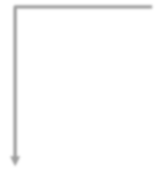
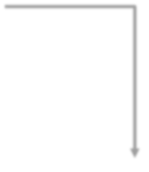

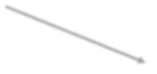


Training Cycle - LLM
There are 2 types of fine-tuning that we can do.
Instruct
Task Specific Finetuning
Domain Specific Finetuning
Summarization
Classification
Sentiment Analysis
Medicine
Finance
Legal
Notes:
"Once we have a pretrained LLM, we can customize it further based on our needs. There are two main types of fine-tuning we can do — Task-Specific Fine-Tuning and Domain-Specific Fine-Tuning. Let’s break down the difference between them."
🔧 1. Task-Specific Fine-Tuning
"First, let’s talk about Task-Specific Fine-Tuning. Here, we fine-tune the model to perform a specific kind of task more accurately.
For example:
If we want a model that writes legal summaries,
Or translates from English to French,
Or generates code from natural language,
We collect a dataset that includes input-output pairs for that specific task and fine-tune the model on it.
This helps the model get really good at one particular job, even if the original model was more general-purpose."
📝 Example:
“Fine-tuning GPT to summarize clinical notes for doctors.”
🧠 2. Domain-Specific Fine-Tuning
"Now, the second type is Domain-Specific Fine-Tuning. Here, the goal is not to focus on one task, but to teach the model the language and context of a specific domain.
For instance:
Legal documents
Medical records
Scientific papers
Financial reports
We use large amounts of domain-relevant text, even if it’s not task-labeled, to help the model understand the terminology, tone, and structure used in that domain.
Once domain fine-tuned, the model becomes much better at understanding and generating text in that domain, no matter what the task is."
📝 Example:
“Fine-tuning GPT on thousands of medical textbooks and articles to improve its performance on all healthcare-related tasks.”

Slide 9
Training Cycle - LLM
Another way of adapting LLMs for specific task, which is called In-context” learning.
In-context Learning
Fine-tuning
A method of prompt engineering where the model is shown task demonstrations as part of the prompt.
No change in model
A process of training the LLM on a labelled dataset specific to a particular task.
Change in model parameters.
parameters.
Fine-tuning is a supervised process that leads to a new model, in contrast with in-context learning, which is considered ephemeral.”

Slide 10
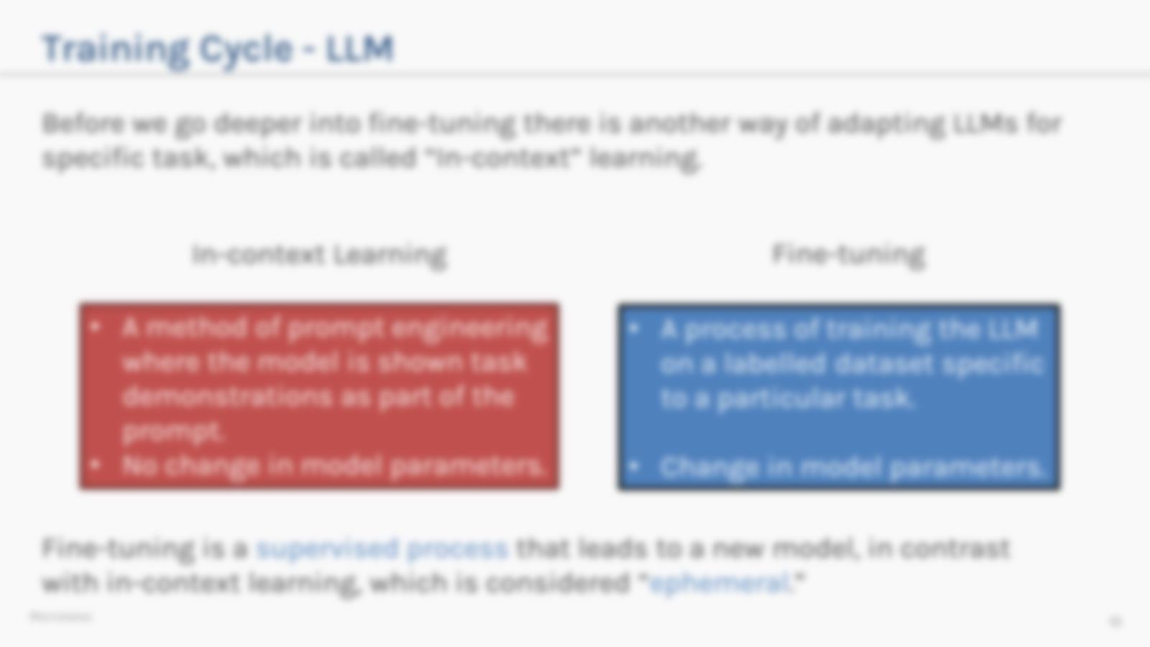
Training Cycle - LLM
Before we go deeper into fine-tuning there is another way of adapting LLMs for
specific task, which is called In-context” learning.
In-context Learning Fine-tuning
_{• A method of prompt} • A process of training the LLM engineering where the model is ^{on a labelled dataset}
_{shown task demonstrations as} specific to a particular task.
part of the prompt.
• No change in model ^{• Change in model} _{parameters.} parameters.
Fine-tuning is a supervised process that leads to a new model, in contrast with in-context learning, which is considered ephemeral.”
PROTOPAPAS ₁₂
You may recall in-context learning from previous lecture with reference to prompting.
Let’s focus on fine-tuning and how it makes our LLM better.

Slide 11
Outline
Training Cycle – LLM
Instruction-tuning
Full Parameter
PEFT
Additive
Adapters -Sparse Adapters-IA3
Soft prompt-Prompt Tuning-Prefix Tuning-P-Tuning-LlaMA Adapter
Selective
BitFit-Freeze and Reconfigure
Reparameterization ( LORA,QLORA)
Hybrid method that is a combination of Reparameterization and Selective

Slide 12
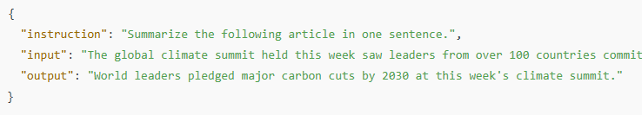
Instruction-tuning (Full Parameter)
Fine-tuning very often means instruction fine-tuning.
An instruction dataset, comprising pairs of instructions, answers, and sometimes context, is required for such fine-tuning.
Protopapas
15

Slide 13
Instruction-tuning (Full Parameter)
Instruction | Context | Output
Suggest a good restaurant | Los Angeles, CA | In Los Angeles, CA, I suggest Rossoblu Italian Restaurant
Rewrite the sentence with more descriptive words | The game is fun | The game is exhilarating and enjoyable
Calculate the area of the triangle | Base: 5cm; Height: 6cm | The area of the triangle is 15 𝑐𝑚²
This is an example of what an instruction dataset looks like.
Source: Alpaca-GPT4 dataset
Protopapas
16

Slide 14
Instruction-tuning (Full Parameter)
Task-specific fine-tuning:
This particular process involves training the model on a smaller, task-specific dataset.
For e.g.: Summarize this, translate that, etc
This allows the model to learn the nuances, and specialized vocabulary relavant to the task.
Notes:
one of the most common ways to adapt a large language model for a particular purpose.
In this process, we train the model on a smaller, focused dataset that is specific to a single task.
For example:
If we want the model to summarize articles, we fine-tune it on a dataset where inputs are long texts and outputs are their summaries.
If we want it to translate languages, we use pairs of sentences — one in the source language, one in the target language.
So the idea is: ‘Give the model examples of the exact job you want it to do, and let it learn from those.’
By doing this, the model starts to pick up on the patterns, tone, structure, and specialized vocabulary that are relevant to that particular task.
It’s like training a general employee to become an expert in one specific job role — the more examples they see, the better they get at it."

Slide 15
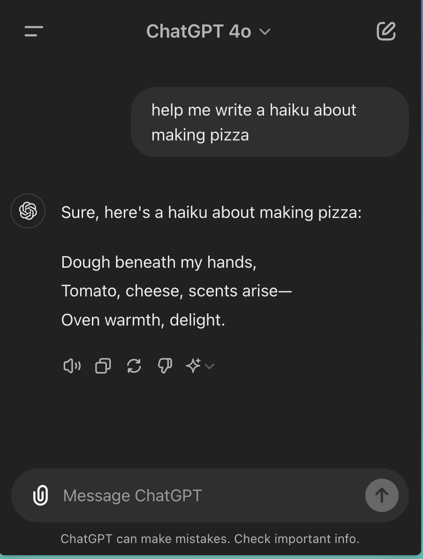
Instruction-tuning (Full Parameter)
For e.g., if you train a model specifically for question answering:
Notice, how it answers requests,
starting with ‘Sure…’.
Notes:
“Now let’s look at Instruction-Tuning, specifically the full parameter version.
This means we’re fine-tuning all the parameters of the model — not just a few layers — to make it better at following instructions in natural language.
For example, imagine we want to train the model for question answering.
We give it lots of examples like:
‘What is the capital of France?’ → ‘The capital of France is Paris.’
‘Who discovered gravity?’ → ‘Isaac Newton discovered gravity.’
Over time, the model learns not just the answers, but also how to respond politely and clearly — often starting with phrases like:
‘Sure, here’s your answer...’ ‘Of course, the capital of France is Paris.’
This is because the instruction-tuning process includes those polite and helpful phrases in the training data.
It’s not just learning facts — it’s learning how to follow instructions and speak like a helpful assistant.
This approach helps the model behave more naturally and predictably in real-world use cases — whether it’s answering questions, writing code, summarizing text, or anything else.”

Slide 16
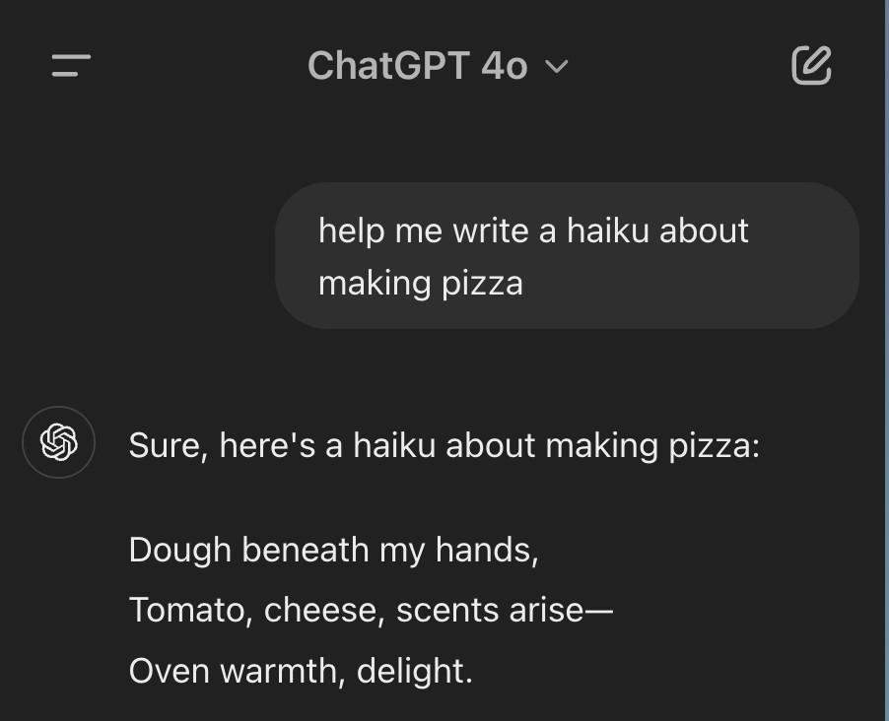
Instruction-tuning (Full Parameter)
For e.g., if you train a model specifically for question answering:
Notice, how it answers requests,
starting with ‘Sure…’.
This is opposed to how language models are trained (next word prediction), according to which the answer should just included the haiku directly.
Notes:
“Now let’s talk about Instruction-Tuning, particularly with full parameter fine-tuning.
This process involves training all the model’s parameters on curated datasets where the model is explicitly taught to follow human instructions — not just predict the next word.
Here’s a simple example: Suppose we want to fine-tune a model specifically for question answering.
We train it on examples where a user asks a question, and the model is expected to respond helpfully and politely.
So instead of just saying:
‘Paris’
The instruction-tuned model learns to respond more like:
‘Sure! The capital of France is Paris.’
Or
‘Of course! Isaac Newton discovered gravity.’
This change in behavior — starting with phrases like “Sure” or “Of course” — reflects its training on instructional prompts, where the model is expected to act like a helpful assistant.
Now, this is quite different from how language models are trained during pretraining. In pretraining, they’re trained via next word prediction.
So if the prompt was:
‘Write a haiku about the ocean’
A pretrained model might simply continue with:
‘Waves crash on the shore / Echoes in the salty breeze / Moonlight kisses foam’
Just the haiku — no explanation, no context, no politeness.
But after instruction-tuning, the same prompt would lead to:
‘Sure! Here’s a haiku about the ocean: Waves crash on the shore / Echoes in the salty breeze / Moonlight kisses foam’
This shows that instruction-tuning doesn't just make the model correct — it makes it cooperative, conversational, and user-aware.

Slide 17
Instruction-tuning (Full Parameter)
We have to be careful while doing task-specific finetuning to avoid catastrophic forgetting.
Catastrophic forgetting refers to the phenomenon where a model loses its ability to perform previously learned tasks when it is being fine-tuned on new tasks.
The key idea of catastrophic forgetting is that as the model learns new tasks, it may overwrite what it previously learned, leading to a loss in performance on earlier tasks.
Notes:
“When we perform task-specific fine-tuning, it’s important to be careful — because we may run into a problem called catastrophic forgetting.
So what exactly is catastrophic forgetting?
It refers to a situation where a model, while learning a new task, forgets how to perform previously learned tasks.
Let’s say we fine-tuned a model to summarize news articles. Now, we decide to fine-tune the same model for sentiment analysis.
If we’re not careful, the model might become very good at sentiment analysis — but completely lose its ability to summarize. Why? Because in the process of learning the new task, it overwrites the internal weights that were important for the previous one.
This is what we call catastrophic forgetting — the model forgets what it once knew because it was never taught to preserve that knowledge while learning something new.
It’s a common challenge in neural networks, especially when models are fine-tuned sequentially on different tasks.

Slide 18
Instruction-tuning (Full Parameter)
To mitigate the problem of catastrophic forgetting, we need to do multi-task finetuning.
This requires a lot of data, and training resources.

Slide 19



Instruction-tuning (Full Parameter)
We need to update all the parameters while finetuning.
For a 7B model, we need to update 7 billion weights. For a 13 billion model, we need to update 13 billion weights.
Storing and updating these weights require a lot of GPU memory.
Fun Fact: Did you know, training GPT-4 involved ~25,000 A100 GPUs over ~90-100 days, costing OpenAI nearly $100 million!

Slide 20
Instruction-tuning (Full Parameter)
Let’s take a fine-tuning example now.
Say we want to finetune a 10 billion parameter model. Let’s see how
that looks in memory.
Assuming, we’re working with FP16 (half precision), which takes approximately 2 bytes per parameter.

Slide 21


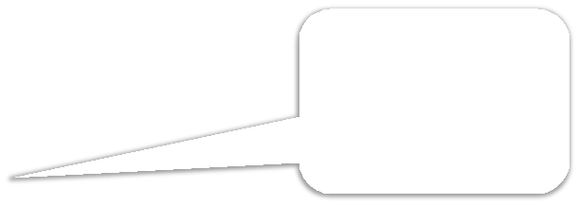






Instruction-tuning (Full Parameter)
Assuming, we’re working with FP16 (half precision), which takes approximately 2 bytes per parameter.
10B parameter model
Parameters(FP16)
20GB
We use the Adam Optimizer.
Gradient(FP16)
20GB
In general, these states need more precision.
Optimizer States(FP32)
120GB
Momentum Variance

Slide 22











Instruction-tuning (Full Parameter)
Assuming, we’re working with FP16 (half precision), which takes approximately 2 bytes per parameter.
NVIDIA RTX 4090
4090
GPU
4090
GPU
4090
GPU
4090
GPU
10B parameter model
Parameters(FP16)
20GB
24GB
24GB
24GB
24GB
Gradient(FP16)
20GB
4090
GPU
4090
GPU
4090
GPU
Optimizer States(FP32)
24GB
24GB
24GB
120GB
Momentum Variance
This model needs at least 7 top-of-the- line consumer-grade
GPU’s to finetune.
Protopapas
26
Notes:
“Let’s walk through a realistic example to understand the hardware demands of fine-tuning a large language model.
Assume we’re working with a 10 billion parameter model, and we want to fine-tune it using FP16, or half-precision format. In FP16, each parameter takes about 2 bytes.
🔢 Memory Calculation
Model Parameters (FP16): 10B × 2 bytes = 20 GB
Gradients (FP16): Also about 20 GB, since gradients are stored in the same precision.
Optimizer States (typically FP32): This includes momentum, variance, and other optimizer internals. These require 4 bytes per parameter, or 40 GB per copy. Usually, 3× the parameter size is used — so: ~120 GB for optimizer states
📊 Total Memory Required
So, to fine-tune this model end-to-end, we need approximately:
20 GB (parameters)
20 GB (gradients)
120 GB (optimizer states)
That’s at least 160 GB of GPU memory needed during training.
💻 Hardware Breakdown
Now let’s look at what that means in terms of actual GPUs.
If we use NVIDIA RTX 4090s, which are top-of-the-line consumer GPUs with 24 GB of memory each, we’ll need at least 7 GPUs just to hold the model and training data in memory.
🔴 You can see in the diagram: We’re stacking seven 4090 GPUs, each contributing 24 GB of VRAM, to meet the memory requirement.
💡 Notice the orange bubble in the image that sums it up perfectly:
“This model needs at least 7 top-of-the-line consumer-grade GPUs to fine-tune.”
🚩 Key Insight
This example highlights a critical challenge in working with large models:
Memory requirements scale rapidly, not just with the model’s size, but also due to the training overhead (like gradients and optimizer states).
For many researchers and developers, this means full-parameter fine-tuning is out of reach — unless you're using a powerful cluster or cloud setup.
✅ Takeaway: Fine-tuning a 10B model in FP16 requires well over 150 GB of memory, and realistically 7 or more high-end GPUs. This is why many turn to parameter-efficient fine-tuning methods like LoRA, prefix-tuning, or adapter layers as alternatives.

Slide 23
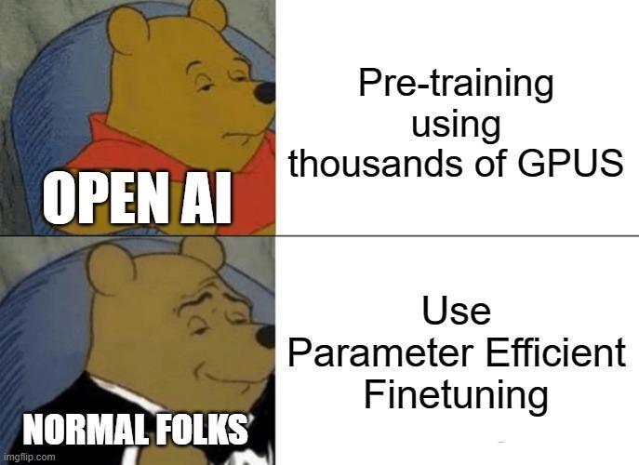
Instruction-tuning (Full Parameter)
This makes full parameter finetuning inaccessible to normal folks like us.
So, what can we do?
Protopapas
27

Slide 24
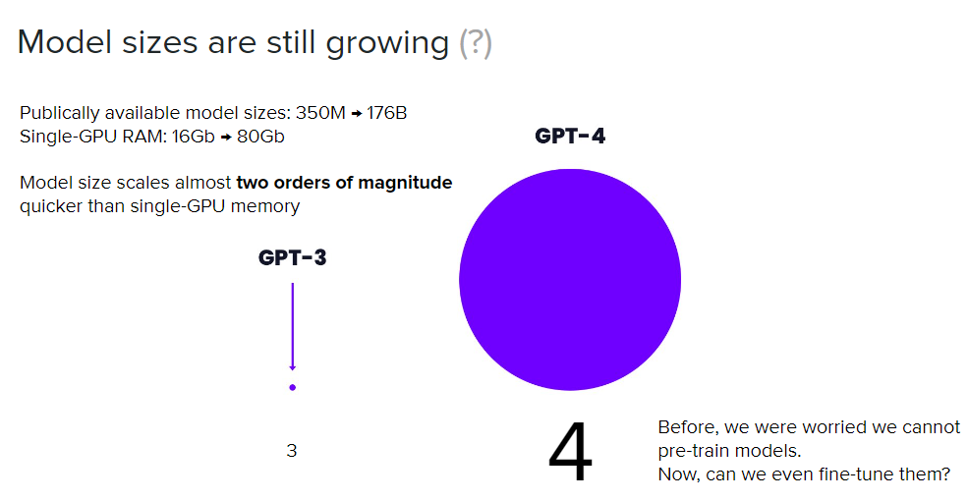

Slide 25
Large Language Models (LLMs) are quite large by name. These models usually have anywhere from 7 to 70 billion parameters. To load a 70 billion parameter model in full precision would require 280 GB of GPU memory! To train that model you would update billions of tokens over millions or billions of documents. The computation required is substantial for updating those parameters. The self-supervised training of these models is expensive, costing companies up to $100 million.
Parameter-Efficient Fine-Tuning (PEFT) can significantly help in adapting large language models (LLMs) for various tasks while overcoming limitations associated with traditional fine-tuning methods

Slide 26
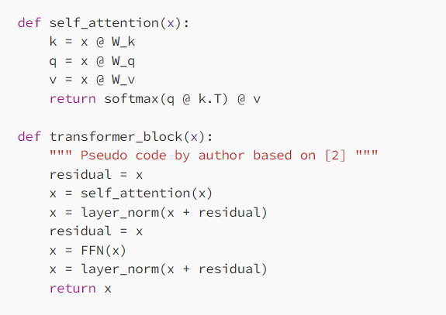
Transformer - recap

Slide 27
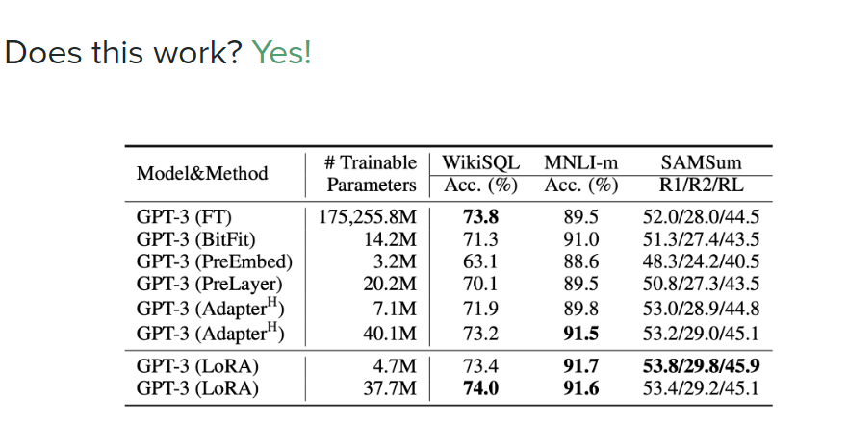

Slide 28
Outline
Training Cycle – LLM
Instruction-tuning
Full Parameter
PEFT
Additive
Adapters -Sparse Adapters-IA3
Soft prompt-Prompt Tuning-Prefix Tuning-P-Tuning-LlaMA Adapter
Selective
BitFit-Freeze and Reconfigure
Reparameterization ( LORA,QLORA)
Hybrid method that is a combination of Reparameterization and Selective

Slide 29
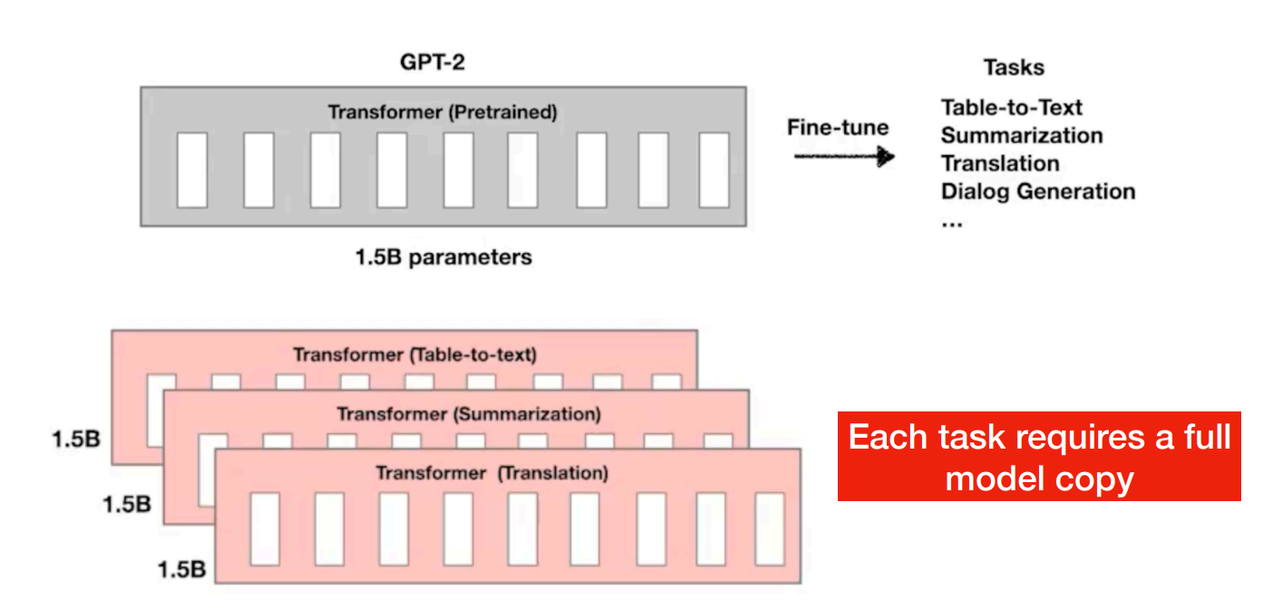
Parameter efficient Fine-tuning (PEFT)
Fine-tuning a model requires to store as many parameters as the original model
High storage complexity
PEFT: An approach for finetuning large language models in a parameter-efficient manner
Source: peft (anoopsarkar.github.io)

Slide 30
Instruction-tuning (PEFT)
PEFT stands for Parameter Efficient Finetuning.
Unlike full parameter finetuning, PEFT preserves the vast majority of
the model’s original weights.
There are majorly three methods to do PEFT.
Additive
Selective
Reparameterization
Protopapas
29
Notes:
“Now that we’ve seen how expensive and memory-intensive full parameter fine-tuning can be, let’s look at a much more efficient alternative — called PEFT, or Parameter-Efficient Fine-Tuning.
🔍 What is PEFT?
PEFT stands for Parameter-Efficient Fine-Tuning.
Unlike full fine-tuning, where all the parameters of the model are updated, PEFT is a smarter approach: It preserves the vast majority of the model’s original weights and only tunes a small subset of parameters — often less than 1% of the model.
This makes it:
Much lighter on memory
Faster to train
And often just as effective for downstream tasks
🧠 How does PEFT work?
There are three major methods to implement PEFT:
Additive Methods
These methods add new parameters (like small adapter modules or LoRA layers) to the model.
The base model remains frozen, and the new modules are the only parts that are trained.
Example: LoRA (Low-Rank Adaptation)
Selective Methods
Here, we selectively fine-tune only a few layers or components of the model.
For example, just the layer norms, or the last few transformer blocks.
Everything else stays untouched.
Reparameterization Methods
These involve modifying how the model represents its parameters.
Instead of directly learning new weights, the model learns a more compact or constrained form — like using low-rank matrices or parameter decompositions.

Slide 31
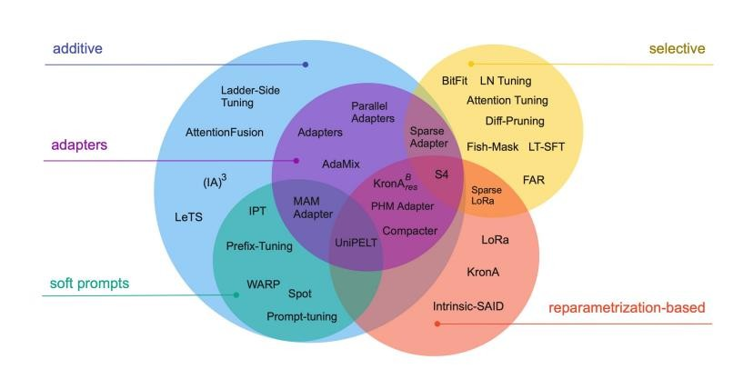
Instruction-tuning (PEFT)
Add trainable layers or parameters to model
Subsets the parameters to finetune
Add new trainable layers to the architecture called ‘Adapters’
Reparametrize model weights using a new representation
Focuses on manipulating the input (not the same as prompt engineering)
Source: paper Scaling Down to Scale Up”
(arxiv.org³)¹
Protopapas

Slide 32
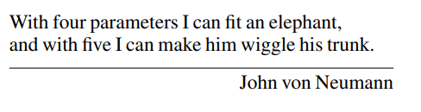

Slide 33
PEFT – classifications
Does the method introduce new parameters to the model?
Does it fine-tune a small subset of existing parameters?
Does the method aim to minimize memory footprint or storage efficiency?
Additive methods
Selective methods
Reparametrization-based methods
Hybrid methods
Lialin, V., Deshpande, V., & Rumshisky, A. (2023). Scaling down to scale up: A guide to parameter-efficient fine-tuning. arXiv preprint arXiv:2303.15647.

Slide 34
Outline
Training Cycle – LLM
Instruction-tuning
Full Parameter
PEFT
Additive
Adapters -Sparse Adapters-IA3
Soft prompt-Prompt Tuning-Prefix Tuning-P-Tuning-LlaMA Adapter
Selective
BitFit-Freeze and Reconfigure
Reparameterization ( LORA,QLORA)
Hybrid method that is a combination of Reparameterization and Selective

Slide 35
Additive Method
Additive methods are probably the easiest to grasp.
The goal of additive methods is to add an additional set of parameters or network layers to augment the model.
When fine-tuning the data you update the weights only of these newly added parameters.
This makes training computationally easier and also adapts to smaller datasets

Slide 36
Additive Methods
Key idea: Augment the existing pre-trained model with additional parameters or layers and train only the added parameters
Introduce additional parameters. However, achieve significant training time and memory efficiency improvements
Two approaches
Adapters
Soft prompts

Slide 37
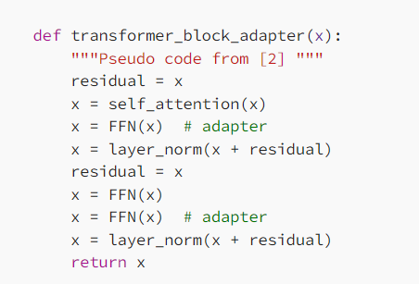
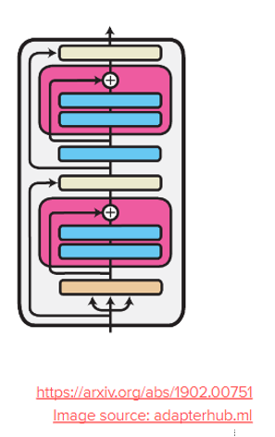
Adapters
This technique was introduced in Houlsby et al [4]. The goal of adapters is to add small fully connected networks after Transformer sub-layers and learn those parameters

Slide 38
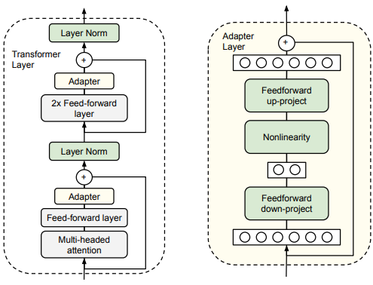
Source: Houlsby, Neil, Andrei Giurgiu, Stanislaw Jastrzebski, Bruna Morrone, Quentin De Laroussilhe, Andrea Gesmundo, Mona Attariyan, and Sylvain Gelly. "Parameter-efficient transfer learning for NLP." In International Conference on Machine Learning, pp. 2790-2799. PMLR, 2019.

Slide 39
Adapters
Attach a small fully connected layer at every layer of the transformer
Inserts small modules (adapters) between transformer layers
Adapter layer performs a down projection to project the input hidden layer information to a lower-dimensional space, followed by a non-linear activation function and an up projection
A residual connection to generate the final form
Only adapter layers are trainable, while the parameters of the original LLMs are frozen
Notes:
“Now, let’s dive into a popular type of additive method called adapters.
Adapters work by attaching a small fully connected layer—called an adapter—at every layer inside the transformer model. Essentially, these adapters are tiny modules inserted between the transformer’s original layers.
Here’s what happens inside each adapter: first, it takes the input hidden state from the transformer and projects it down into a smaller, lower-dimensional space. Then, it applies a non-linear activation function to add complexity, and finally, it projects the data back up to the original dimension.
To make sure the original information flows through smoothly, adapters use a residual connection—meaning the output of the adapter is added back to the original hidden state.
The key thing to remember is: during fine-tuning, only these adapter layers are trained. The rest of the large language model’s parameters stay frozen, which helps reduce the computational cost and makes training more efficient.”

Slide 40
Down projection: This is a linear transformation that reduces the dimensionality of the input hidden layer information (h) from the original LLM. Imagine squeezing a high-dimensional vector into a lower-dimensional one, focusing on the most relevant aspects for the specific task.
Let h be the input vector representing the hidden layer information from the original LLM (usually a high-dimensional vector).
We define a down-projection matrix (W_down) with dimensions appropriate for the desired reduction in dimensionality. This matrix essentially "compresses" the information.
The down projection is calculated by multiplying the input vector h with the down-projection matrix W_down:
z = W_down * h
Here, z represents the lower-dimensional representation of the input data.

Slide 41
Up projection: After processing in the lower-dimensional space, the data (z) is projected back to its original size (h'). This might seem redundant, but it allows the model to integrate the learned information from the lower-dimensional space back into the original context, enriching the representation.
Up Projection:
After processing in the lower-dimensional space, we want to project the data back to its original size.
We define an up-projection matrix (W_up) with dimensions that allow us to expand the data back to the original size of the input vector h.
The up projection is calculated by multiplying the lower-dimensional vector z with the up-projection matrix W_up:
h' = W_up * z
Here, h' represents the data projected back to its original dimensionality.

Slide 42
Outline
PEFT
Additive
Adapters -Sparse Adapters-IA3
Soft prompt-Prompt Tuning-Prefix Tuning-P-Tuning-LlaMA Adapter
Selective
BitFit-Freeze and Reconfigure
Reparameterization ( LORA,QLORA)
Hybrid method that is a combination of Reparameterization and Selective

Slide 43
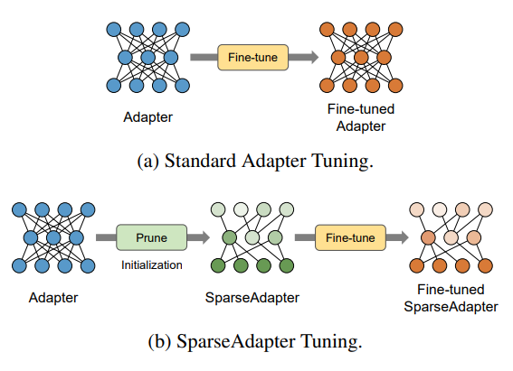
Sparse Adapter
Pruned adapters
Reduces the model size of neural networks by pruning redundant parameters and training the rest ones
Source:He, Shwai, Liang Ding, Daize Dong, Miao Zhang, and Dacheng Tao. "Sparseadapter: An easy approach for improving the parameter-efficiency of adapters." arXiv preprint arXiv:2210.04284 (2022).
Notes:
Imagine you have a regular adapter layer with 1,000 parameters. Not all of these parameters are equally important—some contribute a lot to the model’s performance, while others have very little effect.
Sparse adapters work by identifying and removing these less important or redundant parameters. Suppose after pruning, only 300 parameters remain—these are the ones that really matter.
By training just these 300 parameters instead of all 1,000, the model becomes smaller and faster to train, without losing much accuracy.
Think of it like cleaning out a toolbox—you keep only the tools you actually need, so you can work more efficiently without carrying unnecessary weight

Slide 44
Implementing sparse adaptation involves incorporating sparsity techniques within the adapter layers of a PEFT (Parameter-Efficient Fine-Tuning) framework for large language models (LLMs).
Choosing a Sparsity Technique:
There are several ways to introduce sparsity in adapter layers. Here are two common approaches:
Pruning:
Start with a fully connected adapter layer (all weights have non-zero values).
During or after training, iteratively remove connections (set their weights to zero) considered unimportant based on specific criteria.
Common pruning algorithms include:
Magnitude-based pruning: Removes weights with values below a certain threshold.
Gradient-based pruning: Removes weights that contribute minimally to the gradient during training.
Magnitude Thresholding:
Initialize all weights in the adapter layer with random values.
After training, set weights with absolute values below a certain threshold to zero, effectively making them inactive.
Notes:
“When it comes to making adapter layers sparse, there are several techniques you can use. Let me walk you through two common approaches: pruning and magnitude thresholding.
First, pruning. Imagine you start with a fully connected adapter layer where all the weights are active—none are zero. During or after training, you remove connections that aren’t important by setting their weights to zero. This is done iteratively, based on certain criteria.
For example:
Magnitude-based pruning removes weights that are smaller than a set threshold. These small weights don’t contribute much, so it’s safe to remove them.
Gradient-based pruning removes weights that barely affect the training process, meaning their gradients are very small.
To put it simply, pruning is like trimming a tree: you cut off the branches that don’t add value to the shape.
The second approach is magnitude thresholding. Here, you start by initializing all weights randomly in the adapter layer. After training, you look at the absolute value of each weight and set to zero any weight below a certain threshold. These weights become inactive, making the layer sparse.
Think of magnitude thresholding like sorting coins—only keeping the ones that are above a certain size and putting the tiny ones away.”

Slide 45
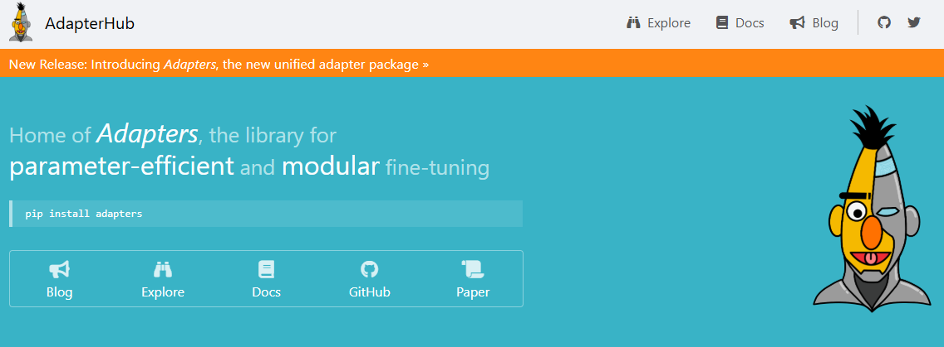
AdapterHub
An easy-to-use and extensible adapter training and sharing framework for transformer-based model
AdapterHub is a framework designed to simplify the process of integrating, training, and using adapter modules for parameter-efficient fine-tuning of transformer-based language models.

Slide 46
Outline
PEFT
Additive
Adapters -Sparse Adapters-IA3
Soft prompt-Prompt Tuning-Prefix Tuning-P-Tuning-LlaMA Adapter
Selective
BitFit-Freeze and Reconfigure
Reparameterization ( LORA,QLORA)
Hybrid method that is a combination of Reparameterization and Selective

Slide 47
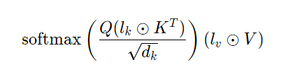
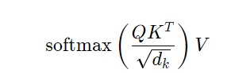
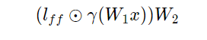
Additive PEFT ( IA3)- Infused Adapter by Inhibiting and Amplifying Inner Activations
We just added column vectors l_k and l_v and take the Hadamard product between the column vector and the matrix (multiply the column vector against all columns of the matrix).
Let’s consider the scaled dot-product attention found in a normal transformer:
We also introduce one other learnable column vector l_{ff} that is added to the feed forward layers as follow:
we are working with an additive method, we are seeking to add parameters to this network. We want the dimensionality to be quite small. (IA)³ proposes the following new vectors to be added to the attention mechanism:
In this example, gamma is the activation function applied to the product between the weights and input
The Hadamard product ⊙,. Each element (c_ij) in the resulting matrix C is calculated by multiplying the corresponding elements (a_ij and b_ij) from matrices A and B at the same position (i, j).
Notes:
“Let’s look at a special kind of additive parameter-efficient fine-tuning called IA3, which stands for Inhibiting and Amplifying Inner Activations.
IA3 works by infusing adapters that don’t add extra layers but instead modulate the internal activations of the model during training.
Specifically, it learns small vectors that scale (amplify) or suppress (inhibit) the activations inside certain layers of the transformer.
This approach is lightweight and efficient because it only adjusts these scaling factors rather than the full set of parameters, making fine-tuning faster and less resource-heavy.
So, instead of adding new layers like traditional adapters, IA3 tweaks the existing inner workings to adapt the model
“Think of IA3 like adjusting the volume knobs on a mixing board instead of adding new instruments to a song.
In a transformer model, each layer produces certain activations — like sounds from different instruments.
Instead of adding new layers (new instruments), IA3 learns small vectors that turn up or turn down the volume (amplify or inhibit) of these activations.
By carefully adjusting these ‘volume knobs,’ the model can emphasize important signals and quiet down less relevant ones, effectively fine-tuning its behavior without adding much complexity.
This makes IA3 a very lightweight and efficient way to personalize large models.”**

Slide 48
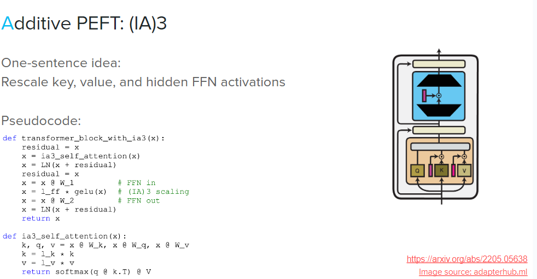

Slide 49
Outline
PEFT
Additive
Adapters -Sparse Adapters-IA3
Soft prompt-Prompt Tuning-Prefix Tuning-P-Tuning-LlaMA Adapter
Selective
BitFit-Freeze and Reconfigure
Reparameterization ( LORA,QLORA)
Hybrid method that is a combination of Reparameterization and Selective

Slide 50
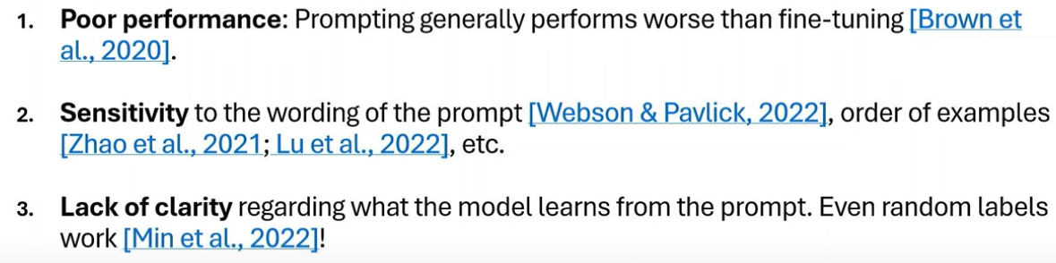
Downsides of In Context Learning
Notes:
Poor performance bcz llms assumes something and give ans...model may not learn some aspects of the domain
Sensitivity- if ip or op is long the order in which u place also get affected … assumptions in different models may be different\
Lack of clarity reg the model understand from the prompt
We want to provide the ex in a detailed manner

Slide 51
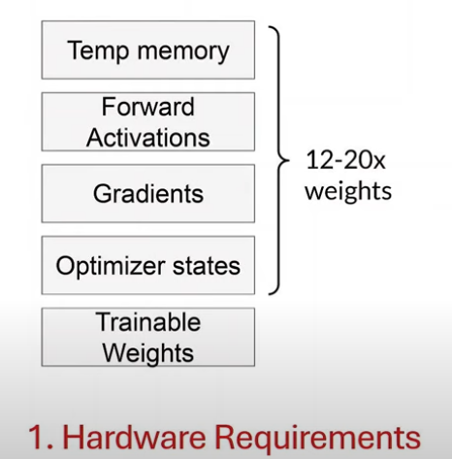
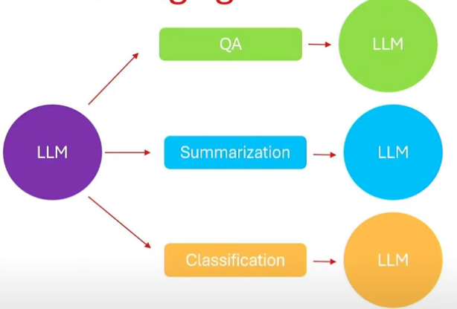
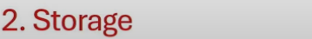
Why is Full Finetuning in LLM Challenging?
Notes:
"Let’s take a look at why full fine-tuning of large language models is so challenging, both from a hardware and storage perspective.
On the left side of the slide, we see the hardware requirements involved in full fine-tuning. Fine-tuning a model means we’re not just updating the trainable weights — we also have to store a lot of extra information during training. This includes gradients, optimizer states like momentum and learning rates, and forward activations needed for backpropagation. On top of that, temporary memory is used for intermediate computations. Altogether, this leads to memory usage that can be 12 to 20 times the size of the model weights. So if the model has 11 billion parameters, we may need memory for 132 to 220 billion parameters during training. That makes fine-tuning extremely hardware-intensive and costly.
Now looking at the right side, we see the storage challenges. If we want to fine-tune the same model for different tasks — like question answering, summarization, or classification — we end up creating and saving a separate full model for each task. That means storing multiple copies of a huge model, each one with 11 billion parameters or more. As the number of tasks grows, the storage demands become completely unmanageable.
So, in summary, full fine-tuning is resource-heavy both in terms of compute and storage. This is exactly why lightweight alternatives like prompt tuning or adapter tuning have gained popularity — they significantly reduce both memory and storage requirements by keeping the core model frozen and only learning a small number of parameters for each task."

Slide 52
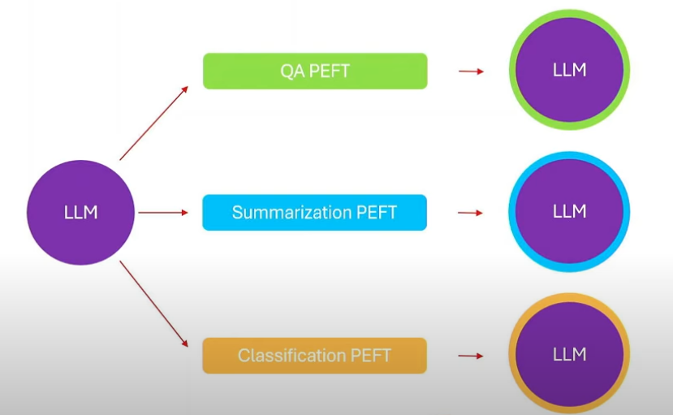
PEFT
Notes:
"Let’s say we want to fine-tune a large language model for three different tasks — question answering, summarization, and text classification.
With traditional full fine-tuning, we would need to create and store a separate copy of the entire model — which might be 11 billion parameters — for each task. That’s incredibly resource-intensive in terms of compute, memory, and storage.
This is where PEFT, or Parameter-Efficient Fine-Tuning, comes in.
Instead of modifying the whole model, PEFT keeps the base model frozen and only fine-tunes a small set of task-specific parameters. These could be prompt embeddings, adapters, or low-rank updates like in LoRA.
As a result, we only need to store and train a small number of additional parameters per task — sometimes as little as 0.1% of the model — drastically reducing hardware and storage requirements.
So now, the same large model can be reused for all tasks, and we just plug in small modules trained for each one. This makes fine-tuning scalable, lightweight, and efficient, especially when dealing with multiple tasks."

Slide 53
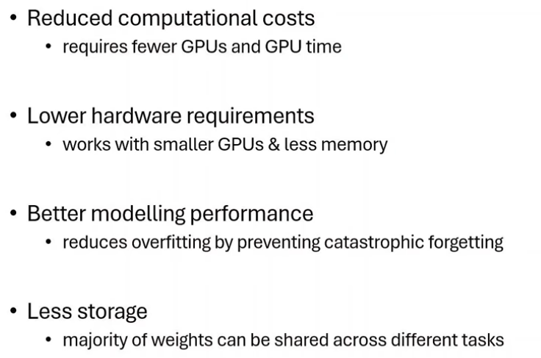
PEFT Advantages

Slide 54
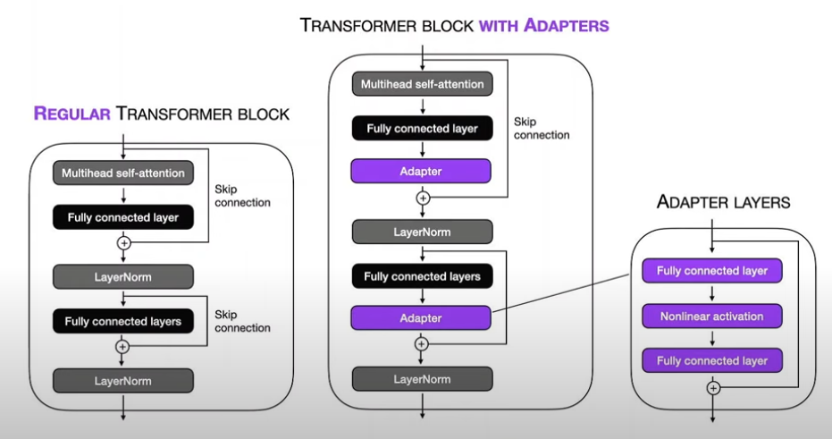
Adapters – Houlsby et al. 2019

Slide 55
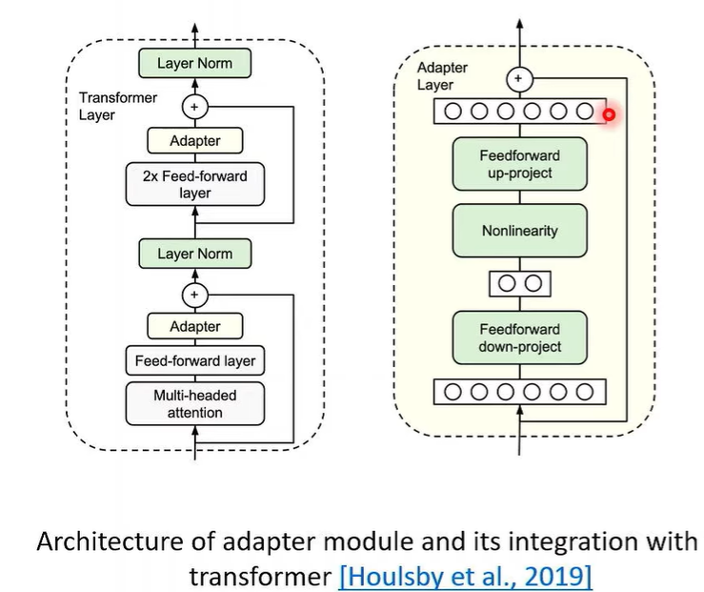

Slide 56
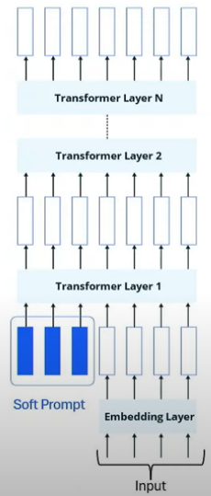
(Soft) Prompt Tuning (Lester et al. 2021)
In Context Tuning- hard prompting
Would it be possible for the model to learn the prompt itself if we have large amount of input/output and a mechansism to measure how good/bad the prompt is?
Reserve some special tokens in the input called soft prompts which are the only trainable parameters

Slide 57
Soft Prompting
With soft-prompts our goal is to add information to the base model that is more specific to our current task. With prompt tuning we accomplish this by creating a set of parameters for the prompt tokens and injecting this at the beginning of the network.
Soft-prompting is a technique that tries to avoid this dataset creation. In hard prompting, we are creating data in a discrete representation (picking words.) In soft-prompting, we seek a continuous representation of the text we will input to the model
Depending on the technique, there are different methods for how the information is added to the network. The core idea is that the base model does not optimize the text itself but rather the continuous representation (i.e. some type of learnable tensor) of the prompt text. This can be some form of embedding or some transformation applied to that embedding.
Notes:
Think of soft prompts like giving the model a “mental hint” in its own internal language — a nudge in vector space — rather than saying it out loud in human language.”

Slide 58
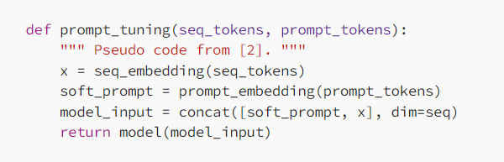
Prompt Tuning:
Trainable Prompt Parameters: This approach focuses on creating a set of trainable parameters specifically for the prompt tokens. These parameters are essentially learned representations of the task that guide the LLM.
Notes:
Suppose you want to fine-tune a large language model to perform sentiment analysis on movie reviews. Instead of modifying the whole model:
You initialize a set of learnable vectors (e.g., 10 vectors of size 768).
You train these vectors on your sentiment dataset.
During inference, these vectors are prepended to each input review's embedding before feeding into the model.
The model uses them to infer sentiment, without altering its original weights.
def prompt_tuning(seq_tokens, prompt_tokens):
x = seq_embedding(seq_tokens) # Get embeddings for input sequence
soft_prompt = prompt_embedding(prompt_tokens) # Get learned embeddings for prompt
model_input = concat([soft_prompt, x], dim=seq) # Prepend soft prompt to input
return model(model_input) # Run through frozen model
The prompt_tuning function demonstrates how soft prompt tuning works for adapting large language models efficiently. It takes two inputs: seq_tokens (the main input sequence) and prompt_tokens (learnable prompt tokens). First, it converts the input sequence into embeddings using seq_embedding(seq_tokens), and then generates embeddings for the soft prompt using prompt_embedding(prompt_tokens). These soft prompt embeddings are prepended to the input embeddings using concatenation along the sequence dimension. The combined embeddings are then passed through the frozen pre-trained model. Importantly, during training, only the soft prompt embeddings are updated, keeping the rest of the model parameters fixed. This approach enables efficient and lightweight fine-tuning for specific downstream tasks.

Slide 59
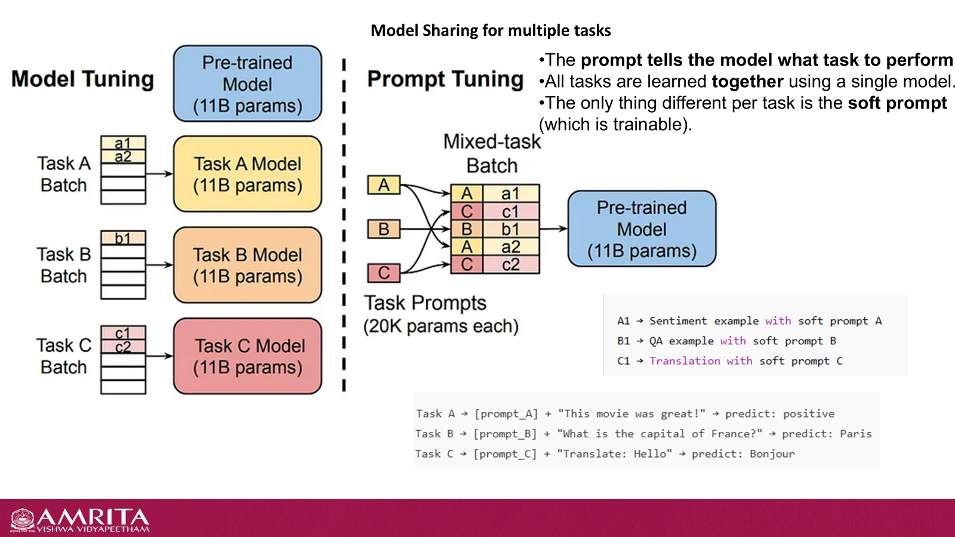
Example sentiment Analysis
Imagine you want to fine-tune a pre-trained LLM for sentiment analysis. Here's how prompt tuning might work:
Define Prompt Template: You create a prompt template with special tokens representing the task and sentiment categories (positive, negative, neutral).
An example template could be:[SENTIMENT] sentiment: __label__ , review: "This movie was fantastic!“
[SENTIMENT] is a special token representing the task (sentiment analysis).__label__ is a placeholder that will be filled with the predicted sentiment during inference.“
This movie was fantastic!" is the actual review text you want the model to analyze.
Trainable Prompt Parameters: The model learns a set of parameters (embeddings) for each special token in the prompt template. These parameters capture the task-specific information.
Feeding the Input: During training and inference, you combine the prompt template with the actual review text, replacing __label__ with a special "unknown" token.
Notes:
Imagine you're fine-tuning a pre-trained large language model (LLM) for sentiment analysis using prompt tuning. You start by defining a prompt template that includes special tokens to represent the task and sentiment categories—such as [SENTIMENT] for the task and __label__ as a placeholder for the predicted sentiment. For example, a prompt might look like: [SENTIMENT] sentiment: __label__ , review: "This movie was fantastic!". In this setup, [SENTIMENT] signals the task type, __label__ is where the model will eventually predict the sentiment (positive, negative, or neutral), and the quoted sentence is the actual review. The model learns embeddings for each special token in the template, capturing task-specific information. During both training and inference, the prompt is combined with the real input, and __label__ is replaced with a special "unknown" token. The model, while frozen, uses the learned prompt embeddings to make accurate sentiment predictions.

Slide 60
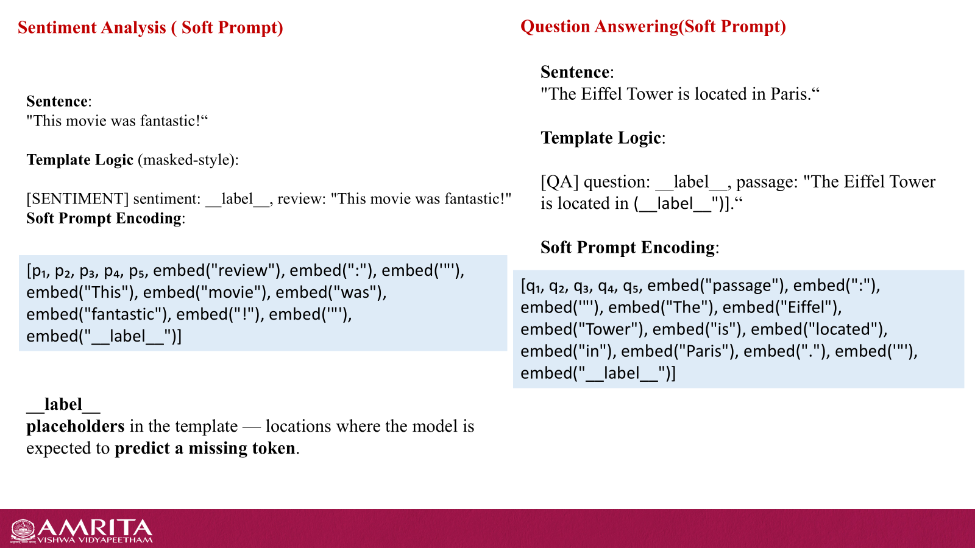

Slide 61
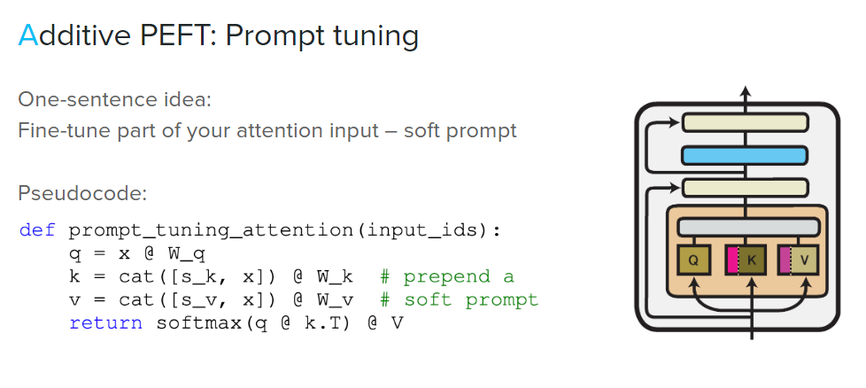
Soft Prompt

Slide 62
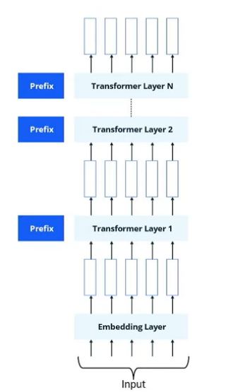
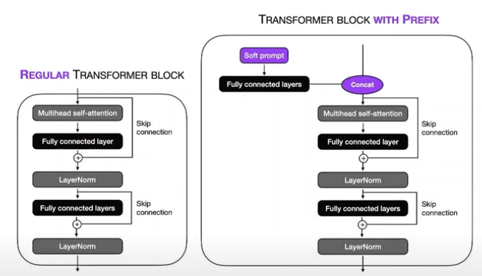
Prefix Tuning – Li & Lang 2021
Small set of trainable parameters in every layer of transformer
Notes:
Small set of trainable parameters in every layer of transformer

Slide 63
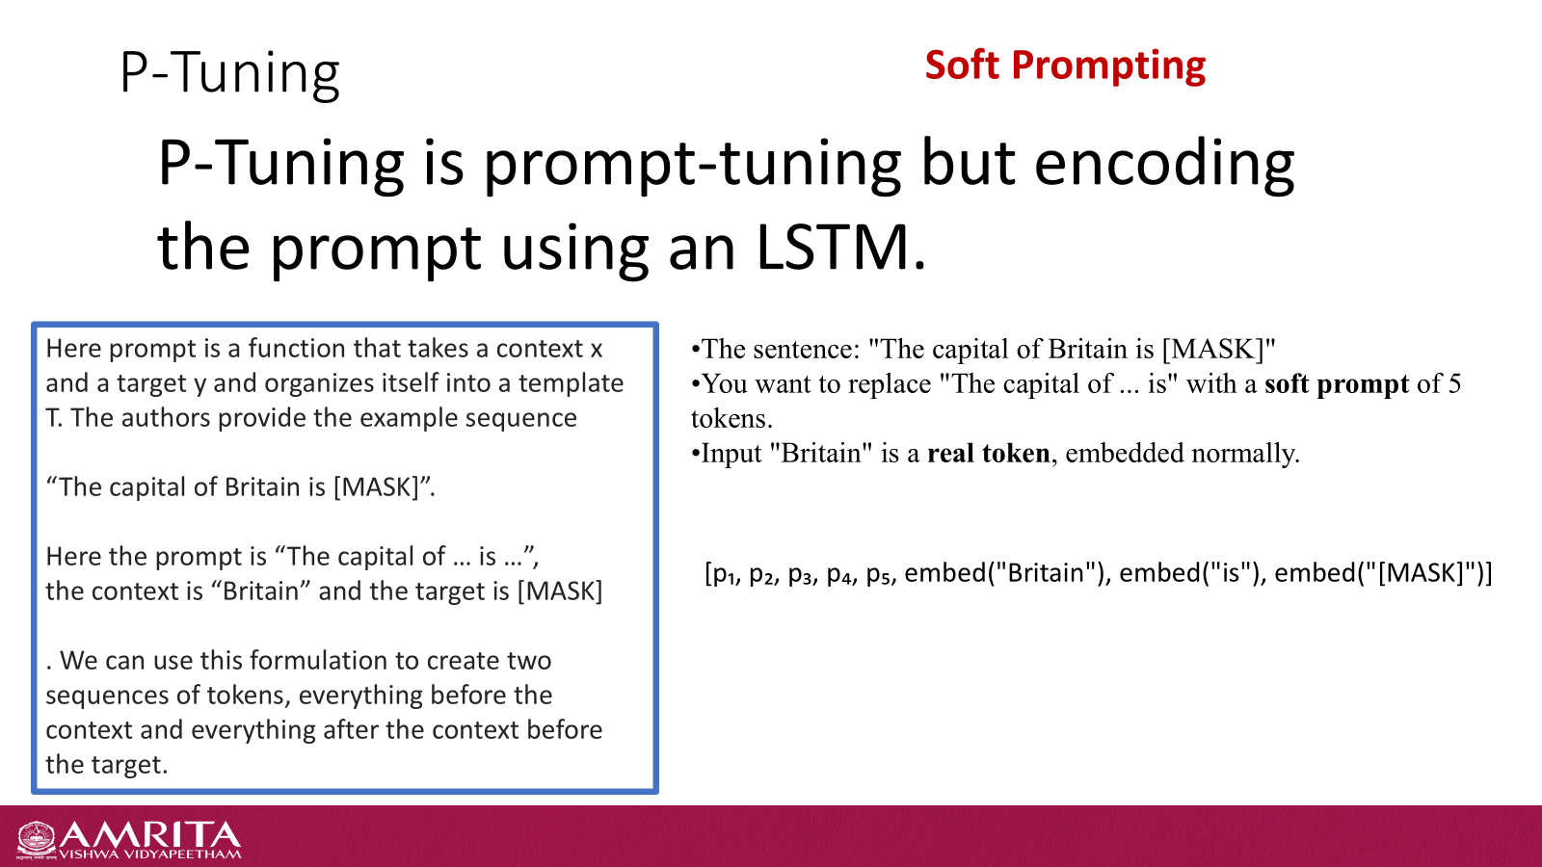

Slide 64
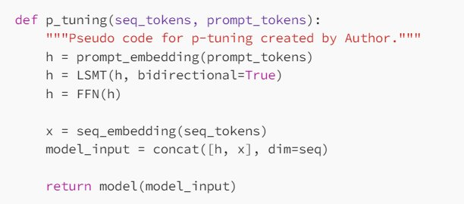

Slide 65
LLaMA adapter
Soft Prompting
LLaMA adapter introduce Adaptation Prompts, which are soft-prompts appended with the input to the transformer layer. These adaption prompts are inserted in the L topmost of the N transformer layers.
With additive methods LLaMA adapter introduce a new set of parameters that have some random initialization over the weights. Because of this random noise added to the LM, we can potentially experience unstable fine-tuning which can cause a problem with large loss values at the early stages.
To solve this problem, the authors introduce a gating factor, initialized to 0, that is multiplied by the self attention mechanism. The product of the gating factor and self-attention is referred to as zero-init attention. The gating value is adaptively tuned over the training steps to create a smoother update of the network parameters.

Slide 66
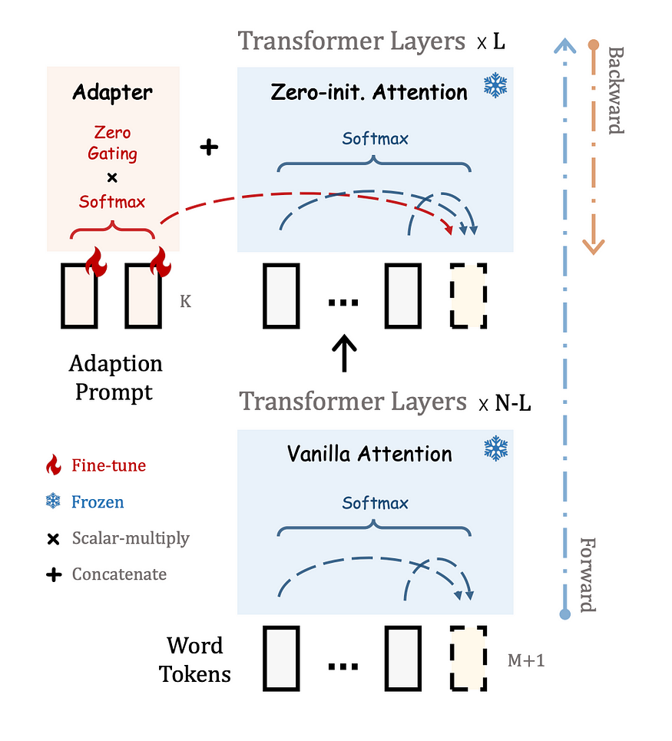
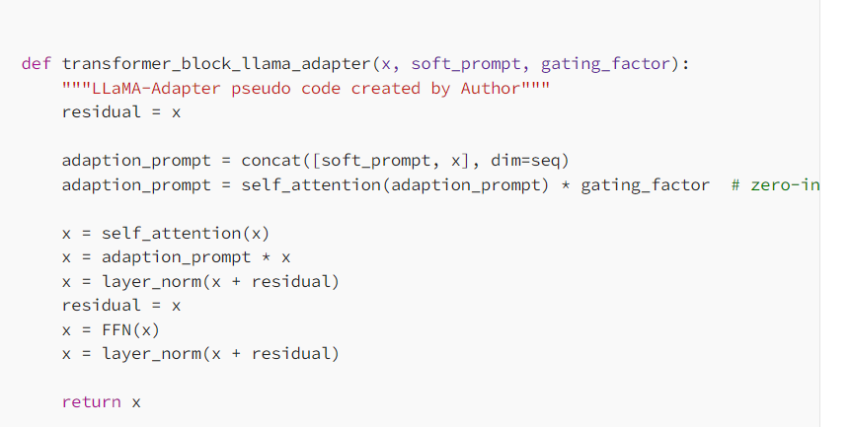
LLaMA adapter

Slide 67
Outline
PEFT
Additive
Adapters -Sparse Adapters-IA3
Soft prompt-Prompt Tuning-Prefix Tuning-P-Tuning-LlaMA Adapter
Selective
BitFit-Freeze and Reconfigure
Reparameterization ( LORA,QLORA)
Hybrid method that is a combination of Reparameterization and Selective

Slide 68
Selective Methods
Selectively fine-tuning some parts of the network
Fine-tuning only a few top layers of a network
Based on the type of the layer
Internal structure of the network (tuning only model biases)
Tuning only particular rows of the parameter matrix
Sparsity-based approaches

Slide 69
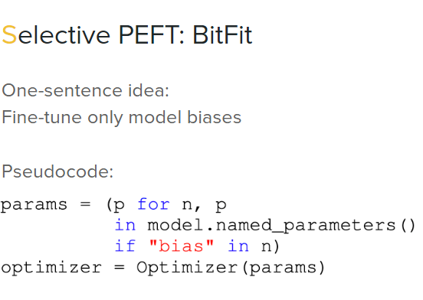

Slide 70
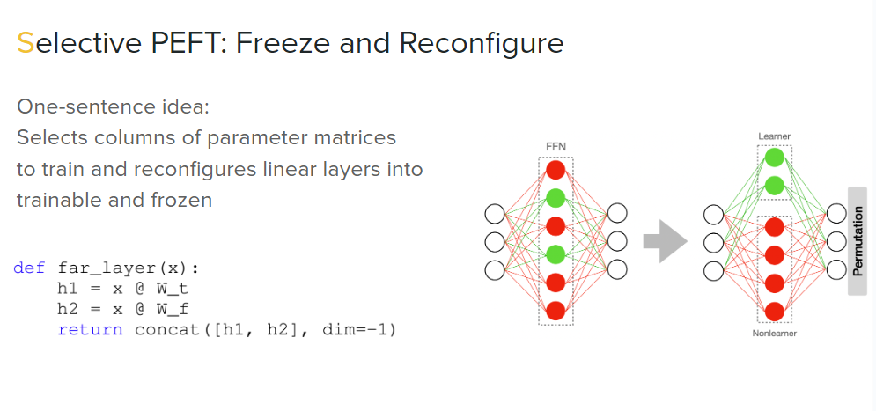
Split your linear layer into 2 matrices based on information measure or gradient measure-Frozen matrix and Trainable matrix
Freezing: This involves keeping certain layers of the pre-trained LLM's architecture unchanged during fine-tuning. These frozen layers typically represent the LLM's core capabilities for understanding language.
Reconfiguring: Specific parts of the LLM, particularly the later layers, are reconfigured to adapt to the target task

Slide 71
Outline
PEFT
Additive
Adapters -Sparse Adapters-IA3
Soft prompt-Prompt Tuning-Prefix Tuning-P-Tuning-LlaMA Adapter
Selective
BitFit-Freeze and Reconfigure
Reparameterization ( LORA,QLORA)
Hybrid method that is a combination of Reparameterization and Selective

Slide 72




LoRA - Intuition
LoRA revolves around the idea that any matrix W ∈ 𝑅^{𝑚×𝑛} can be decomposed into 𝐖 = 𝑩𝑨 where 𝐵 ∈ 𝑅^{𝑚×𝑟} and A ∈ 𝑅^{𝑟×𝑛}
Rank 1
=
×
𝑊
𝐵
𝐴
Protopapas
37

Slide 73


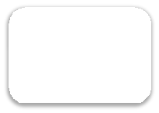

LoRA - Intuition
LoRA revolves around the idea that any matrix W ∈ 𝑅^{𝑚×𝑛} can be decomposed into 𝐖 = 𝑩𝑨 where 𝐵 ∈ 𝑅^{𝑚×𝑟} and A ∈ 𝑅^{𝑟×𝑛}
=
×
𝑊
𝐵
𝐴
25
10
elements
elements

Slide 74
LoRA - Intuition
We can even increase the rank to get better performance.
=
×
𝑊
𝐵
𝐴
25
10
elements
elements

Slide 75



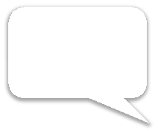






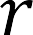
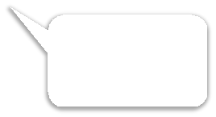

LoRA - Working
Now, we use the same concept of matrix decomposition
while finetuning an LLM.
Update
Scaling parameter
Decomposed matrices
matrix
Initial LLM
Weights
Rank of
𝐵𝐴
Remember, we are decomposing the update matix (Δ𝑊), and not the original weights 𝑊₀.
40

Slide 76




LoRA - Working
We initialize B using a zero matrix, and A using a normal distribution.
Now, let’s look at this diagrammatically.
42

Slide 77














LoRA - Working
ℎ
Pretrained Weights
_{W ε ℝ}𝑑×𝑑
𝐵 = 0
𝑟
A = 𝛮(0, 𝜎²)
𝑑
X
Notice how the reparameterization (LoRA) runs parallel to the
original model.
Protopapas

Slide 78

LoRA - Working
ℎ
Backward Pass
𝐵 = 0
During the backward pass, we don’t use the pre- trained weights and the gradients only flow through the adapters.
Pretrained Weights
_{W ε ℝ}𝑑×𝑑
𝑟
A = 𝛮(0, 𝜎²)
𝑑
X
Notice how the reparameterization (LoRA) runs parallel to the
original model.
Protopapas

Slide 79




LoRA - Working
At inference time, the update matrix can be merged with the original model weights to make the process efficient.
ℎ
Pretrained Weights
_{W ε ℝ}𝑑×𝑑
𝐵 = 0
𝑟
A = 𝛮(0, 𝜎²)
𝑑
X
Notice how the reparameterization (LoRA) runs parallel to the
original model.
Protopapas

Slide 80


LoRA - Intuition
Let’s explore the scale at which LoRA can help reduce the number of parameters needed to achieve comparable performance!

Slide 81
LoRA - Intuition
Number of trainable parameters
Rank | Model 7B | Model 13B | Model 70B | Model 180B
1 | 167K | 228K | 529K | 849K
2 334k 456k 1M 2M
8 1M 2M 4M 7M
16 3M 4M 8M 14M
512 86M 117M 270M 434M
1024 171M 233M 542M 869M
8192 1.4B 1.8B 4.3B 7B
Full 7B 13B 70B 180B

Slide 82
LoRA - Intuition
Number of trainable parameters
Rank | Model 7B | Model 13B | Model 70B | Model 180B
1 | 167K | 228K | 529K | 849K
2 | 334K | 456K | 1M | 2M
8 1M 2M 4M 7M
16 3M 4M 8M 14M
512 86M 117M 270M 434M
1024 171M 233M 542M 869M
8192 1.4B 1.8B 4.3B 7B
Full 7B 13B 70B 180B

Slide 83
LoRA - Intuition
Number of trainable parameters
Rank | Model 7B | Model 13B | Model 70B | Model 180B
1 | 167K | 228K | 529K | 849K
2 | 334K | 456K | 1M | 2M
8 | 1M | 2M | 4M | 7M
16 3M 4M 8M 14M
512 86M 117M 270M 434M
1024 171M 233M 542M 869M
8192 1.4B 1.8B 4.3B 7B
Full 7B 13B 70B 180B

Slide 84

LoRA - Intuition
Number of trainable parameters
Rank | Model 7B | Model 13B | Model 70B | Model 180B
1 | 167K | 228K | 529K | 849K
2 | 334K | 456K | 1M | 2M
8 | 1M | 2M | 4M | 7M
16 | 3M | 4M | 8M | 14M
512 | 86M | 117M | 270M | 434M
1024 | 171M | 233M | 542M | 869M
8192 | 1.4B | 1.8B | 4.3B | 7B
Full | 7B | 13B | 70B | 180B
This is a generalization considering an LLM of one layer. LLMs are made up of multiple layers.

Slide 85
LoRA - Advantages
Compared to full parameter finetuning, LoRA has the following advantages:
Much faster
Finetuning can be achieved using less GPU memory
Cost efficient
Less prone to catastrophic forgetting” since the original model
weights are kept the same.

Slide 86


LoRA – Isn’t it enough?
Full Parameter Fine Tuning
Optimizer State (FP32)
Base Model (FP16)
10B → 160GB

Slide 87

LoRA – Isn’t it enough?
Full Parameter Fine Tuning
Optimizer State (FP32)
Base Model (FP16)
10B → 160GB

Slide 88







LoRA – Isn’t it enough?
Full Parameter Fine Tuning
LoRA
Optimizer State (FP32)
A
B
Optimizer State (FP32)
LoRA
Adapter (FP16)
A
B
Base Model (FP16)
Base Model (FP16)
10B → 160GB
10B → ~40GB

Slide 89







LoRA – Isn’t it enough?
Full Parameter Fine Tuning
LoRA
Optimizer State (FP32)
A
B
Optimizer State (FP32)
LoRA
Adapter (FP16)
A
B
Base Model (FP16)
This will be frozen. So, no optimization, but the parameters
Base Model (FP16)
still needs to be
stored in memory
10B → ~40GB
^{10B →}for¹⁶fo⁰r^{G}w^{B}ard pass

Slide 90

LoRA – Isn’t it enough?
As we can see below, LoRA’s performance is comparative to full parameter fine-tuning and, in some cases, even outperforms it.
These metrics are used for performance evaluation.
Protopapas

Slide 91
LoRA - Summary
LoRA reduces the trainable parameters and memory requirements while maintaining good performance.
LoRA adds pairs of rank decomposition weight matrices (called update matrices) to each layer of the LLM.
Only the update matrices, which have significantly fewer parameters than the original model weights, are trained.
Protopapas
60

Slide 92
QLoRA
Protopapas

Slide 93
QLoRA
QLoRA is the extended version of LoRA which works mainly by quantizing the precision of the network parameters.
Before we dive into what QLoRA is, let’s look at what quantization
is.
Think of quantization as ‘ splitting range into buckets ’.

Slide 94
QLoRA
Think of quantization as ‘ splitting range into buckets ’.
Any number between
0 and 100
1 num =
infinite bytes
27
55.3
83.78
Quantized by
whole numbers
1 num =
0.875 bytes
27
55
83
Quantized by
10s
1 num =
0.5 bytes
(3 bits ~
0.375 bytes)
20
50
80

Slide 95
QLoRA
Let’s look at an example!
Here, FP32 refers to a 32- bit floating-point number.
Let 𝑋^{𝐹𝑃32} be an array of values.
1.5 | 2.3 | 3.7 | 4.1 | 5.6 | 6.8 | 7.9 | 8.4 | 9.2 | 10.2
What if we want to quantize from FP32 to Int8?

Slide 96






QLoRA
So, to quantize 𝑋^{𝐹𝑃32} to 𝑋^{𝐼𝑛𝑡8} :
Int8 values range from -127 to 127
Array of values
The absolute maximum value in the array, 𝑋^{𝐹𝑃32} .

Slide 97






QLoRA
So, to quantize 𝑋^{𝐹𝑃32} to 𝑋^{𝐼𝑛𝑡8} :
_{𝑋}𝐼𝑛𝑡8 _{= 𝑟𝑜𝑢𝑛𝑑(𝑐}𝐹𝑃32_{𝑋}𝐹𝑃32₎

Slide 98


QLoRA
So, to quantize 𝑋^{𝐹𝑃32} to 𝑋^{𝐼𝑛𝑡8} :
_{𝑋}𝐼𝑛𝑡8 _{= 𝑟𝑜𝑢𝑛𝑑(𝑐}𝐹𝑃32_{𝑋}𝐹𝑃32₎

Slide 99
QLoRA
_{𝑋}𝐼𝑛𝑡8 _{= 𝑟𝑜𝑢𝑛𝑑(𝑐}𝐹𝑃32_{𝑋}𝐹𝑃32₎
In our example,
_{𝑋}𝐹𝑃32
1.5 | 2.3 | 3.7 | 4.1 | 5.6 | 6.8 | 7.9 | 8.4 | 9.2 | 10.2
_{𝑐}𝐹𝑃32
=
127
=
127
= 12.4509
𝑎𝑏𝑠𝑚𝑎𝑥 𝑋^{𝐹𝑃32}
10.2
Now, we combine the formula and the values that we
have
Protopapas
68

Slide 100
QLoRA
1.5 | 2.3 | 3.7 | 4.1 | 5.6 | 6.8 | 7.9 | 8.4 | 9.2 | 10.2
𝑋^{𝐼𝑛𝑡8} = 𝑟𝑜𝑢𝑛𝑑(12.4509 x
)
_{𝑋}𝐼𝑛𝑡8 ₌
18 | 29 | 46 | 51 | 69 | 85 | 98 | 105 | 115 | 127
Voila! That’s how we quantize from FP32 to Int8 using the formula:
_{𝑋}𝐼𝑛𝑡8 _{= 𝑟𝑜𝑢𝑛𝑑(𝑐}𝐹𝑃32_{𝑋}𝐹𝑃32₎

Slide 101







QLoRA
_{𝑋}𝐼𝑛𝑡8 _{= 𝑟𝑜𝑢𝑛𝑑(𝑐}𝐹𝑃32_{𝑋}𝐹𝑃32₎
What if we want to dequantize and get back the original array,
_{𝑋}𝐹𝑃32?
Dequantization
To dequantize:
error
Now that we know what quantization is, let’s look at how QLoRA works!

Slide 102

QLoRA – The Pizza
Imagine QLoRA to be a mouthwatering pizza.
Now, to make a pizza, we need to gather a few key ingredients!

Slide 103



QLoRA – The Ingredients
There are 3 key ingredients which helps us make QLoRA:
4-Bit NormalFloat
Double Quantization
Paged Optimizer

Slide 104




QLoRA – Ingredient 1: 4-Bit NormalFloat
4-bit NormalFloat
4-bit NormalFloat is a clever way to split the buckets.
4-bit means we have
2⁴ = 16 possible buckets for quantization.
0
Equally spaced buckets
Equally sized buckets
This is an enhanced version of
quantile quantization.

Slide 105
QLoRA – Ingredient 1: 4-Bit NormalFloat
Why use 4-bit NormalFloat
Designed for efficient storage and computation in machine learning.
Most datasets in machine learning are normally distributed and precision around the mean is valuable.
0
Equally spaced buckets
Equally sized buckets
This is an enhanced version of
quantile quantization.

Slide 106
QLoRA – The Ingredients
There are 3 key ingredients which helps us make QLoRA:
4-Bit NormalFloat
Double Quantization
Paged Optimizer

Slide 107





QLoRA – Ingredient 2: Double Quantization
Remember this formula?
Takes up memory
_{𝑋}𝐼𝑛𝑡8 _{= 𝑟𝑜𝑢𝑛𝑑(𝑐}𝐹𝑃32_{𝑋}𝐹𝑃32₎
Which is not an issue, as it’s just 1 constant. Right?
Now, if we think about this in terms of neural networks….

Slide 108
QLoRA – Ingredient 2: Double Quantization
Now, if we think about this in terms of neural networks….
Let’s take a 5x5 matrix to be the weights in a neural network:
Weight Tensor
-0.7 | -0.3 | 0.0 | -0.4 | 0.3
-1.0 | 0.2 | 0.7 | 1.7 | -0.9
-0.1 | -1.5 | -0.1 | 0.8 | 0.5
1.2 | -1.7 | -0.9 | -0.3 | 0.7
0.4 | 0.1 | -1.4 | 2.2 | -1.1

Slide 109



QLoRA – Ingredient 2: Double Quantization
Now, if we think about this in terms of neural networks….
Weight Tensor
Rescaled Weight Tensor
-0.7 | -0.3 | 0.0 | -0.4 | 0.3
-1.0 | 0.2 | 0.7 | 1.7 | -0.9
-0.1 | -1.5 | -0.1 | 0.8 | 0.5
1.2 | -1.7 | -0.9 | -0.3 | 0.7
0.4 | 0.1 | -1.4 | 2.2 | -1.1
-4 | -2 | 0 | -22 | 16
-60 | 10 | 40 | 99 | -57
-5 | -88 | -9 | 48 | 27
72 | -100 | -50 | -18 | 40
22 | 8 | -81 | 127 | -66
Rescale all parameters
𝑢𝑠𝑖𝑛𝑔 𝑐
If we bring back the formula:
Protopapas
𝑟𝑜𝑢𝑛𝑑
_{𝑊}𝐹𝑃32_{𝑐}𝐹𝑃32
_{= 𝑊}𝐼𝑛𝑡8
78

Slide 110


QLoRA – Ingredient 2: Double Quantization
Now, if we think about this in terms of neural networks….
Weight Tensor Rescaled Weight Tensor
-0.7 -0.3 0.0 -0.4 0.3 ₋₄ ₋₂ ₀ ₋₂₂ ₁₆
^{-1.0 0.2 0.7 1.7 -0.9} Rescale all parameters ⁻⁶⁰ ¹⁰ ⁴⁰ ⁹⁹ ⁻⁵⁷
-0.1 -1.5 -0.1 0.8 0.5 ₋₅ ₋₈₈ ₋₉ ₄₈ ₂₇
𝑢𝑠𝑖𝑛𝑔 𝑐
1.2 -1.7 -0.9 -0.3 0.7 ₇₂ ₋₁₀₀ ₋₅₀ ₋₁₈ ₄₀
0.4 0.1 -1.4 2.2 -1.1 ₂₂ ₈ ₋₈₁ ₁₂₇ ₋₆₆
If we bring back the formula: 𝑟𝑜𝑢𝑛𝑑 𝑊^{𝐹𝑃32}𝑐^{𝐹𝑃32} = 𝑊^{𝐼𝑛𝑡8}
PROTOPAPAS ₇₉
We quantize to Int8 for simplicity but
when we implement QLoRA we use
4-bit Normal Float.

Slide 111



QLoRA – Ingredient 2: Double Quantization
Now, if we think about this in terms of neural networks….
Weight Tensor
Rescaled Weight Tensor
-0.7 | -0.3 | 0.0 | -0.4 | 0.3
-1.0 | 0.2 | 0.7 | 1.7 | -0.9
-0.1 | -1.5 | -0.1 | 0.8 | 0.5
1.2 | -1.7 | -0.9 | -0.3 | 0.7
0.4 | 0.1 | -1.4 | 2.2 | -1.1
-4 | -2 | 0 | -22 | 16
-60 | 10 | 40 | 99 | -57
-5 | -88 | -9 | 48 | 27
72 | -100 | -50 | -18 | 40
Rescale all parameters
𝑢𝑠𝑖𝑛𝑔 𝑐
22
8
-81
¹²⁷Do y⁻⁶o⁶u see a problem
here?
If we bring back the formula:
Protopapas
𝑟𝑜𝑢𝑛𝑑
_{𝑊}𝐹𝑃32_{𝑐}𝐹𝑃32
_{= 𝑊}𝐼𝑛𝑡8

Slide 112






QLoRA – Ingredient 2: Double Quantization
Let’s see how the weight tensors look like on the graph.
+10000
0
This is unbounded and could take up any maximum value (an outlier!).

Slide 113




QLoRA – Ingredient 2: Double Quantization
Let’s see how the weight tensors look like on the graph.
+10000
This could introduce bias
0
This is unbounded and could take up any maximum value (an ou^{i}t^{n}lºie^{u}r^{r}!).
quantization
process

Slide 114

So, how do we avoid this problem?
QLoRA – Ingredient 2: Double Quantization
Let’s see how the weight tensors look like on the graph.
+10000
_{0 in} This could _{s}
troduce bia
This is unbounded and could take up any maximum value (an ou^{i}t^{n}lºie^{u}r^{r}!).
quantization
process
PROTOPAPAS ₈₃

Slide 115
QLoRA – Ingredient 2 : Double Quantization
The answer to that is: Block-wise Quantization, which is the first step in Double Quantization!
Let’s look at an example to understand this concept.
We take the weight tensor that we saw in the previous slides.
Weight Tensor (𝑊^{𝐹𝑃32})
-0.7 | -0.3 | 0.0 | -0.4 | 0.3
-1.0 | 0.2 | 0.7 | 1.7 | -0.9
-0.1 | -1.5 | -0.1 | 0.8 | 0.5
1.2 | -1.7 | -0.9 | -0.3 | 0.7
0.4 | 0.1 | -1.4 | 2.2 | -1.1
84

Slide 116
QLoRA – Ingredient 2 : Double Quantization
We flatten the matrix as follows:
Now we divide it up into different blocks.
We calculate the quantization constants for each block.
Weight Tensor (𝑊^{𝐹𝑃32})
-0.7
-0.3
0.0
-0.4
0.3 -1.0
0.2
0.7
1.7
-0.9
-0.1
-1.5
-0.1
0.8
0.5 1.2
-1.7
-0.9
-0.3
0.7 0.4
0.1
-1.4
2.2
-1.1
𝑐_{𝑖}
𝑐_{𝑗} 𝑐_{𝑘} 𝑐_{𝑙}
𝑐_{𝑚}
If there are any outliers in a block, they won’t
affect the quantisation in the other blocks.
Protopapas
85

Slide 117


QLoRA – Ingredient 2 : Double Quantization
127
𝐶^{𝐼𝑛𝑡8} = 𝑟𝑜𝑢𝑛𝑑( 𝐶^{𝐹𝑃32})
Weight Tensor (𝑊^{𝐹𝑃32})
𝑎𝑏𝑠𝑚𝑎𝑥 𝐶^{𝐹𝑃32}
-0.7
-0.3
0.0
-0.4
0.3 -1.0
0.2
0.7
1.7
-0.9
-0.1
-1.5
-0.1
0.8
0.5 1.2
-1.7
-0.9
-0.3
0.7 0.4
0.1
-1.4
2.2
-1.1
𝑐_{𝑖} | 𝑐_{𝑗} | 𝑐_{𝑘} | 𝑐_{𝑙} | 𝑐_{𝑚}
181.4 | 74.7 | 84.7 | 74.7 | 57.7
We now rescale all the parameters per block.
-127 | -54 | 0 | -73 | 54 | -77 | 13 | 51 | 127 | -74 | -9 | -127 | -12 | 70 | 40 | 93 | -127 | -64 | -24 | 52 | 22 | 8 | -81 | 127 | -66
Protopapas
Rescaled Weight Tensor (𝑊^{𝐼𝑛𝑡8})
86

Slide 118






QLoRA – Ingredient 2 : Double Quantization
𝑐^{𝐹𝑃32} is an array of
We now have a new array:
1
all the constants
from each block of the Weight Tensor.
_{𝑐}𝐹𝑃32
𝑐_{𝑖} | 𝑐_{𝑗} | 𝑐_{𝑘} | 𝑐_{𝑙} | 𝑐_{𝑚}
1
Now, we repeat the same process of quantization for the quantization constants.
Double Quantization
_{𝑐}𝐼𝑛𝑡8 _{= 𝑟𝑜𝑢𝑛𝑑(𝑐}𝐹𝑃32_{𝑐}𝐹𝑃32₎
1 2 1
87

Slide 119
QLoRA – Ingredient 2 : Double Quantization
_{𝑐}𝐼𝑛𝑡8 _{= 𝑟𝑜𝑢𝑛𝑑(𝑐}𝐹𝑃32_{𝑐}𝐹𝑃32₎
1 2 1
Let’s see the difference in memory usage before and after
Double Quantization.

Slide 120
QLoRA – Ingredient 2 : Double Quantization
Before
All we had was a weight matrix containing FP32 values.
In our example, we had a 5x5 matrix.
Each value was 4 bytes in size.
So, the total memory used 25x4=100 bytes
was:
-0.7 | -0.3 | 0.0 | -0.4 | 0.3
-1.0 | 0.2 | 0.7 | 1.7 | -0.9
-0.1 | -1.5 | -0.1 | 0.8 | 0.5
1.2 | -1.7 | -0.9 | -0.3 | 0.7
0.4 | 0.1 | -1.4 | 2.2 | -1.1
Weight Tensor (𝑊^{𝐹𝑃32})
Next, let’s look at the memory usage after
Double Quantization.

Slide 121
QLoRA – Ingredient 2 : Double Quantization
Before
25x4=100 bytes
After
-127 | -54 | 0 | -73 | 54
-77 | 13 | 51 | 127 | -74
-9 | -127 | -12 | 70 | 40
93 | -127 | -64 | -24 | 52
22 | 8 | -81 | 127 | -66
_{𝑐}𝐹𝑃32
𝑐_{𝑖} | 𝑐_{𝑗} | 𝑐_{𝑘} | 𝑐_{𝑙} | 𝑐_{𝑚}
2
_{𝑐}𝐼𝑛𝑡8
1
5x1=5bytes.
4 bytes
Rescaled Weight Tensor _{(𝑊}𝐼𝑛𝑡8₎
25x1=25 bytes.
So, in total:
25 + 5 + 4 = 34 bytes

Slide 122
QLoRA – Ingredient 2 : Double Quantization
After
Before
-127 | -54 | 0 | -73 | 54
-77 | 13 | 51 | 127 | -74
-9 | -127 | -12 | 70 | 40
93 | -127 | -64 | -24 | 52
22 | 8 | -81 | 127 | -66
𝑐_{𝑖} | 𝑐_{𝑗} | 𝑐_{𝑘} | 𝑐_{𝑙} | 𝑐_{𝑚}
-0.7 | -0.3 | 0.0 | -0.4 | 0.3
-1.0 | 0.2 | 0.7 | 1.7 | -0.9
-0.1 | -1.5 | -0.1 | 0.8 | 0.5
1.2 | -1.7 | -0.9 | -0.3 | 0.7
0.4 | 0.1 | -1.4 | 2.2 | -1.1
_{𝑐}𝐹𝑃32
2
25 + 5 + 4 = 34 bytes
25x4=100 bytes
That is an approximate 70% reduction in memory
usage!!

Slide 123
QLoRA – The Ingredients
There are 3 key ingredients which helps us make QLoRA:
4-Bit NormalFloat
Double Quantization
Paged Optimizer

Slide 124

QLoRA – Ingredient 3
Before we talk about the third ingredient in QLoRA, let’s talk about
a problem.
A problem which all of us have faced while training a Neural Network
Running Out of Memory!
So, how do we train a modern Neural Networks without taking a hit on the memory?
We use gradient checkpointing.

Slide 125
QLoRA – Ingredient 3
Imagine this simple neural network
X
ℎ₁
ℎ₂
ℎ₃
𝑦ො
Layer 1
Layer 2
Layer 3
Layer 4
When we do a forward-pass, we calculate the activations for each layer.

Slide 126
QLoRA – Ingredient 3
X
ℎ₁
ℎ₂
ℎ₃
𝑦ො
Layer 1 Layer 2 Layer 3
However, this takes up precious memory.
Layer 4
Modern-day computers have become very efficient at parallel processing. What they lack is memory.
We don’t need to store all the hidden states.

Slide 127
QLoRA – Ingredient 3
We only store in memory what is needed at the moment.
We keep discarding activations that have already been used to calculate the next dependent hidden state’s activation.
So, let’s see how it looks!
X
ℎ₁
ℎ₂
ℎ₃
𝑦ො
Layer 1
Layer 2
Layer 3
Layer 4

Slide 128
QLoRA – Ingredient 3
X
𝑦ො
Layer 1
Layer 2
Layer 3
Layer 4
During backpropagation, we must recompute all the discarded activations.
To manage this, we introduce checkpoints in the middle.

Slide 129
QLoRA – Ingredient 3
X
ℎ₁
ℎ₂
ℎ₃
𝑦ො
Layer 1
Layer 2
Layer 3
Layer 4
Checkpoints are usually placed at every have a n-layer neural network.
𝑛 layer, considering we
So, now when we re-compute the activations for backward pass,
we don’t have to start from the beginning!

Slide 130
QLoRA – Ingredient 3
X
ℎ₂
𝑦ො
Layer 1
Layer 2
Layer 3
Layer 4
This allows us to mitigate the OOM (Out of memory) error to some
extent, but it doesn’t get rid of it!
We still see some memory spikes especially when we pass in long sequences in the batch.

Slide 131

This is where our third ingredient comes
QLoRA – Ingredient 3
X ℎ₂ 𝑦ො
Layer 1 Layer 2 Layer 3 Layer 4
This allows us to mitigate the OOM (Out of memory) error to some
extent, but it doesn’t get rid of it!
We still see some memory spikes especially when we pass in long sequences in the batch.
PROTOPAPAS ₁₀₃
in!

Slide 132



QLoRA – Ingredient 3 : Paged Optimizer
Paging is a memory management technique, where RAM is divided into fixed-size blocks called ‘pages’
Paged Optimizer - Looping in your CPU
It does automatic page-to-page transfers between CPU and GPU
Avoids the gradient checkpointing memory spikes that occur when processing a mini batch with a long sequence length.
GPU Memory has space now.
GPU
CPU
Now that the GPU has space, when a page moved to CPU is required, we move it back to GPU for computation.
GPU Memory is full
104

Slide 133
QLoRA – The Ingredients
We saw the 3 key ingredients needed to make QLoRA:
4-Bit NormalFloat
Double Quantization
Paged Optimizer
Let’s bring it all
PRtOToOPAgPASether.
105

Slide 134






QLoRA – Putting it all together
Full Parameter Fine Tuning
LoRA
Optimizer State (FP32)
A
B
Optimizer State (FP32)
LoRA
Adapter (FP16)
A
B
Base Model
Base Model
FP16
FP16
10B => 160GB
10B => ~40GB

Slide 135







QLoRA – Putting it all together
Before we talk about the 3 ingredients, there is another key difference that we should know.
ℎ
Pretrained Weights
_{W ε ℝ}𝑑×𝑑
𝐵 = 0
In QLoRA we use BF16 (BrainFloat16) as compared to FP16 in LoRA.
BF16
BF16
𝑟
A = 𝛮(0, 𝜎²)
BF16
This leads to a change in precision which is tailor-made for deep learning tasks.
𝑑
X

Slide 136














QLoRA – Putting it all together
ℎ
Ingredient 1:
4-Bit NormalFloat
Pretrained Weights
_{W ε ℝ}𝑑×𝑑
𝐵 = 0
BF16
BF16
We store W, as 4-Bit NormalFloat
𝑟
NF4
A = 𝛮(0, ₂𝜎²)
BF16
A = 𝛮(0, 𝜎 )
Ingredient 2:
Double Quantization
𝑑
X
To convert and store, we make use of Double Quantization!

Slide 137









QLoRA – Putting it all together
ℎ
Forward Pass
During the forward pass, we first dequantize the W weights from NF4 to BF16 for computation.
Pretrained Weights
_{W ε ℝ}𝑑×𝑑
𝐵 = 0
BF16
BF16
𝑟
NF4
BF16
A = 𝛮(0, 𝜎²)
We then use the BF16 values of W, A and B to perform the required calculations.
𝑑
X
The BF16 values of W is then deleted
to save on storage!

Slide 138
QLoRA – Putting it all together
ℎ
Backward Pass
As in LoRA, we keep W weights frozen and allow the gradients to only flow through the adapters.
Pretrained Weights
_{W ε ℝ}𝑑×𝑑
𝐵 = 0
BF16
𝑟
NF4
BF16
We then repeat the cycle of forward and backward passes till a minima is reached.
A = 𝛮(0, 𝜎²)
𝑑
X

Slide 139





QLoRA – Putting it all together
QLoRA
Ingredient 3:
Paged Optimizer
CPU
Optimizer State (FP32)
LoRA Adapter (BF16)
Pages are moved to the CPU from the GPU when it does not have space and moved back to GPU for when it’s required and there is space.
Base Model
4bit NormalFloat
Protopapas
10B => ~12GB
111

Slide 140












QLoRA – Putting it all together
Putting it mathematically,
Initial LLM
Weights
Scaling parameter
Let’s start with LoRA:
Decomposed matrices
Weights of LoRA:
𝛼
𝑊₀ + _{𝑟} 𝐵𝐴
Rank of B and A
Forward pass in LoRA:

Slide 141


QLoRA – Putting it all together
Y = X𝑊₀ + 𝑋𝐵𝐴
Let’s expand the formula and see how it looks!
_{𝑌}𝐵𝐹16 ₌
𝛼
_{+ 𝑋}𝐵𝐹16_{𝐵}𝐵𝐹16_{𝐴}𝐵𝐹16
𝑋^{𝐵𝐹16}𝑑𝑜𝑢𝑏𝑙𝑒𝐷𝑒𝑞𝑢𝑎𝑛𝑡 𝑐^{𝐹𝑃32}, 𝑐^{𝑘−𝑏𝑖𝑡}, 𝑊^{𝑁𝐹4}
1 2 𝑜
𝑟
where 𝑑𝑜𝑢𝑏𝑙𝑒𝐷𝑒𝑞𝑢𝑎𝑛𝑡 𝑐^{𝐹𝑃32}, 𝑐^{𝑘−𝑏𝑖𝑡}, 𝑊^{𝑁𝐹4}
1 2 𝑜
= 𝑑𝑒𝑞𝑢𝑎𝑛𝑡 𝑑𝑒𝑞𝑢𝑎𝑛𝑡 c^{FP32}, c^{k−bit}
1 2
_{, W}4bit
𝑜
_{= W}BF16

Slide 142

THANK YOU

Slide 143
Namah Shivaya

Slide 144
https://medium.com/@shravankoninti/decoding-strategies-of-all-decoder-only-models-gpt-631faa4c449a#:~:text=In%20the%20previous%20blog%20we,steps%20and%20it%20generates%20outputs.
https://medium.com/@shravankoninti/generative-pretrained-transformer-gpt-4b94d017a3f9
https://medium.com/@shravankoninti/generative-pretrained-transformer-gpt-pre-training-fine-tuning-different-use-case-c93bb0553ffc
https://medium.com/@shravankoninti/generative-pretrained-transformer-gpt-4b94d017a3f9
https://medium.com/@YanAIx/step-by-step-into-gpt-70bc4a5d8714
https://jalammar.github.io/illustrated-gpt2/
https://learn.deeplearning.ai/courses/finetuning-large-language-models/lesson/1/introduction

